Slide 1
Math in Motion Plus: Move the Cone Challenge
Texas Instruments
@ticalculators

Slide 2
MAKE IT MOVE!
SQUARE PROGRAM:
Send "CONNECT RV”
Send "RV FORWARD 2”
Send "RV LEFT “
Send "RV FORWARD 2”
Send "RV LEFT “
Send "RV FORWARD 2”
Send "RV LEFT “
Send "RV FORWARD 2”
Send "RV LEFT “
Task: Make Rover drive a square.
Commands are found by pressing menu, 8:Hub, 7:Rover (RV), 1:Drive RV
Challenge: edit your program to make Rover drive a triangle

Slide 3
MAKE IT MOVE!
SQUARE PROGRAM:
Send("CONNECT RV")
Send("RV TO XY 2 0")
Send("RV TO XY 2 2")
Send("RV TO XY 0 2")
Send("RV TO XY 0 0")
Task: Make Rover drive a square using coordinates.
Commands are found by pressing menu, 8:Hub, 7:Rover (RV), 1:Drive RV
Challenge: edit your program to make Rover drive a triangle using coordinates

Slide 4
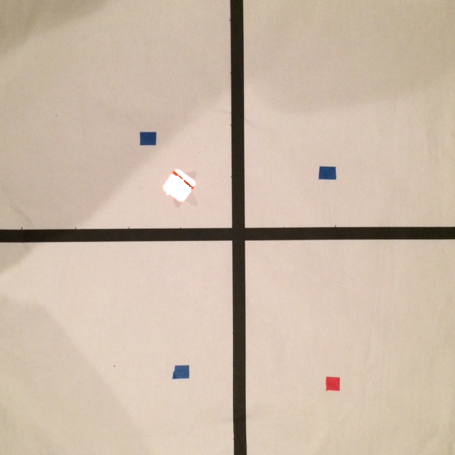
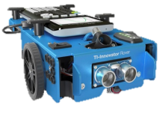
Your challenge: Move the cone
Beginning at the origin: drive around the 3 blue “dots” then push the cone from the yellow dot to the red dot. Closest to the red dot wins!
Your starting code:
Send "CONNECT RV”
Send "RV TO XY 1 0”

