Slide 2
New European Content Portal

Slide 3
Content? – What do you mean?
Traditional
Today & Future
Activities
  DOC, PDF, TNS, …
Activities
  DOC, PDF, TNS, …
Videos
  Youtube, Teachertube, …
Webinars
  From T³, TI and others
Links
  Interactive STEM websites and other

Slide 4

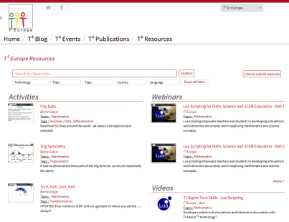


Content Sources
T3 authoring teams
Content Repository
TI content
Individual authors
Textbook publishers et al.

Slide 5
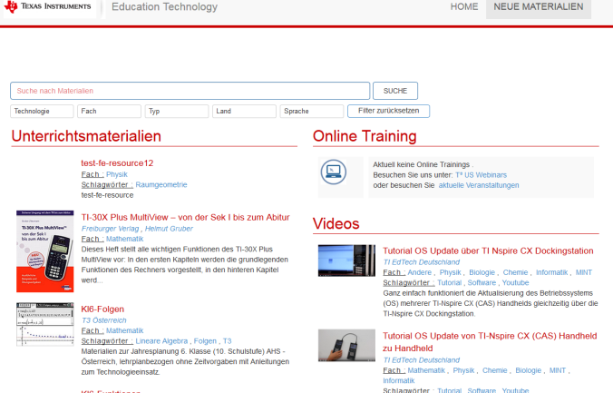

Content Delivery
TI Style
Content Repository
Filter
Filter
T3 Style

Slide 6
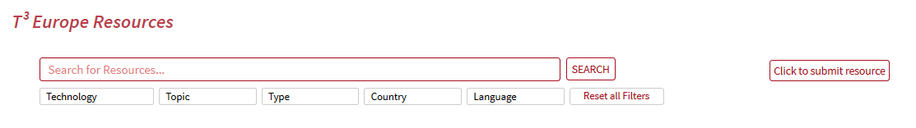
Search Bar
Tag search
Login and
Resource submission
Filters

Slide 7
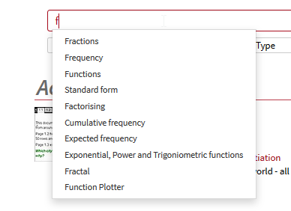
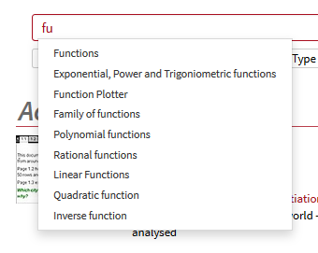
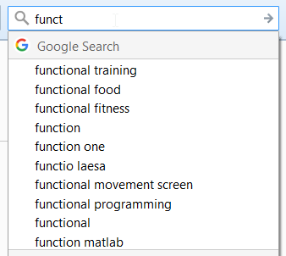
Search by Tag
Enter tag…
Find
Google
Alphabetic tag search
Content portal
Contextualized tag search

Slide 8
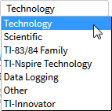
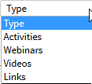
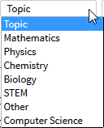
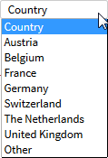
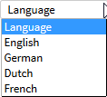
Filter Options

Slide 9
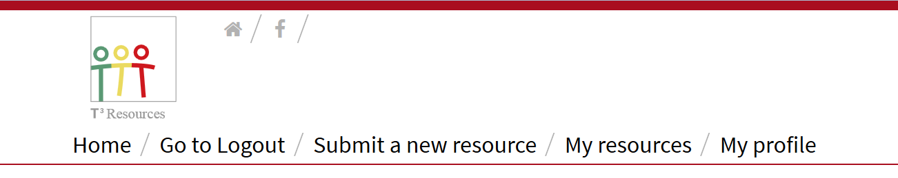
Manage your resources yourself

Slide 10
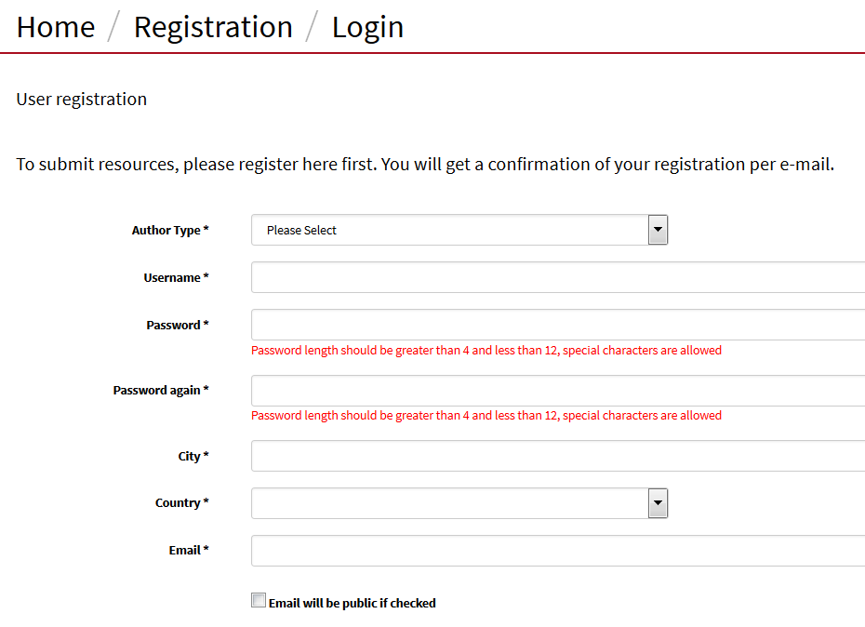

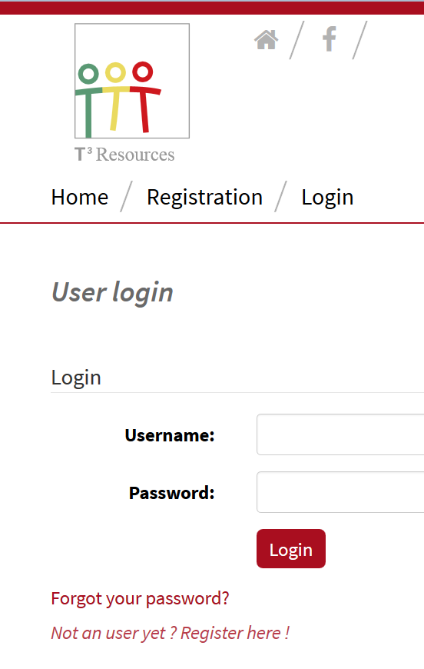
Registration & Login

Slide 11
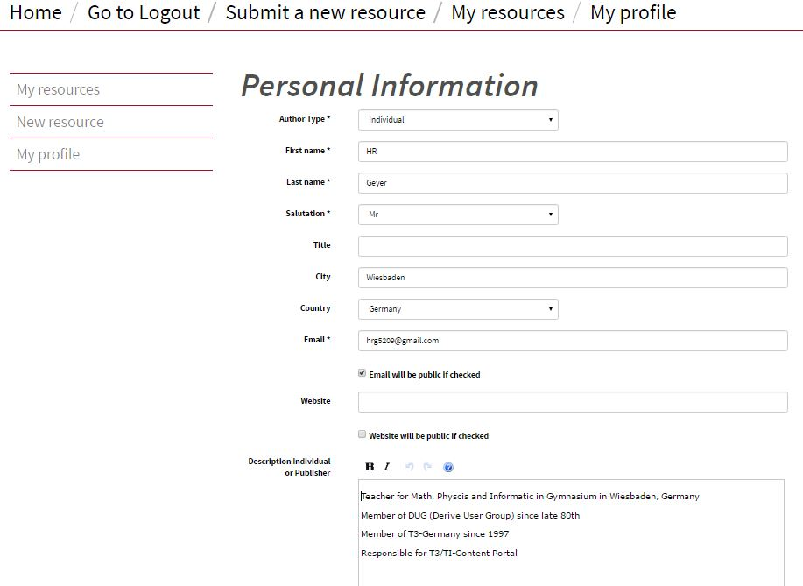
My Profile

Slide 12
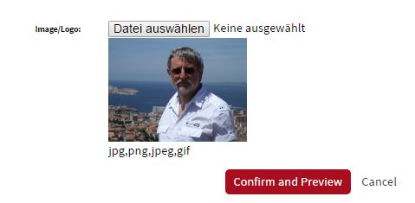
My Profile

Slide 13
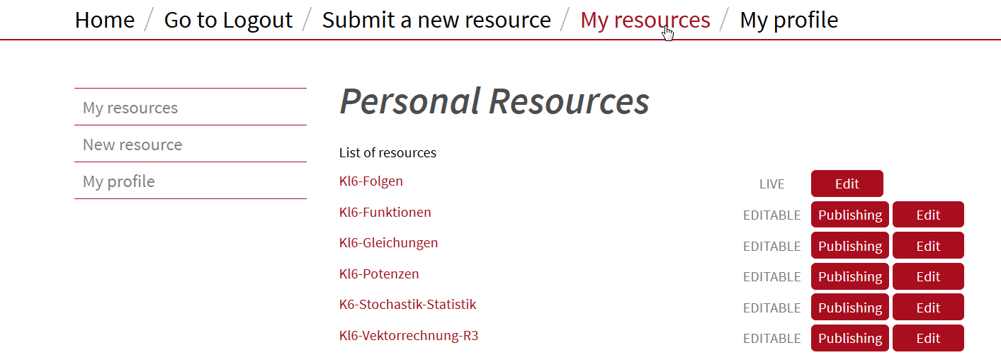
My Resources

Slide 14
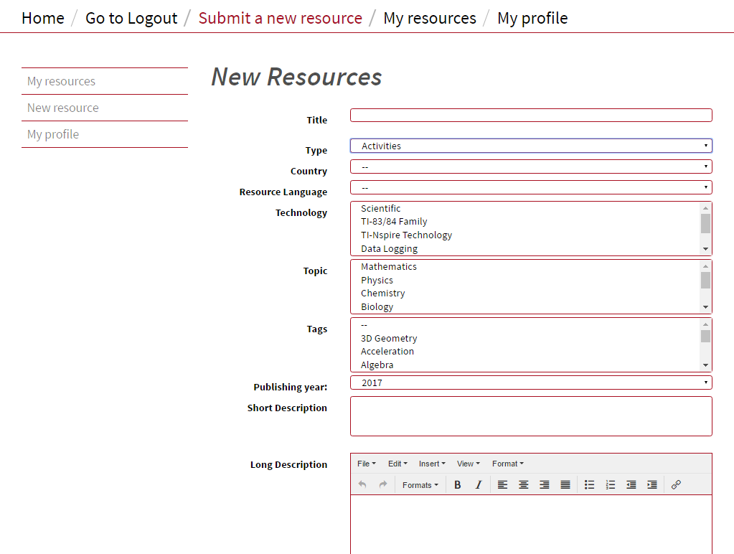
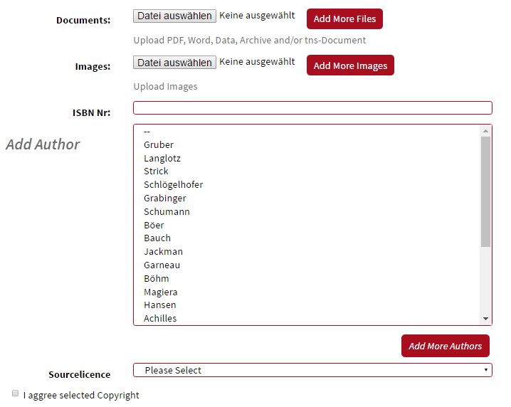
Submit a new resource

Slide 15
Formalities
Registration required
we would like to know with who we are dealing
Terms & Conditions required
clarification of roles and responsibilities
Protection against inappropriate submissions
Submission => Approval => Go live
Edit => Approval => Go live

Slide 16
Now it‘s your turn! You go live!
http://www.t3europe.eu/home/
http://www.ti-unterrichtsmaterialien.net

