Slide 1



Computational Thinking
with Python in the Math Classroom
k-stulens@ti.com
b.wikkerink@gmail.com
www.t3nederland.nl
www.wil-depython.nl
www.t3europe.eu

Slide 2

Computational Thinking with Python
in the Math Classroom
What is computational thinking?
Mathematical examples
Graphical patterns & creativity

Slide 3
Computational Thinking
Computational thinking is the thought processes involved in formulating problems and their solutions so that the solutions are represented in a form that can be effectively carried out by an information-processing agent
Jeannette Wing, 2006

Slide 4
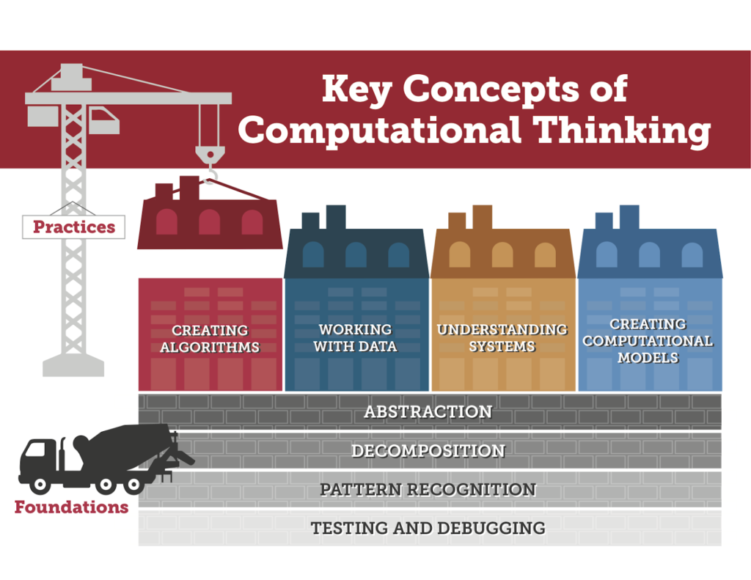
Computational Thinking
digitalpromise.org
Computational thinking is the thought processes involved in formulating problems and their solutions so that the solutions are represented in a form that can be effectively carried out by an information-processing agent
Jeannette Wing, 2006

Slide 5

Computational Thinking
digitalpromise.org
ComputerBasedMath
Computational thinking is the thought processes involved in formulating problems and their solutions so that the solutions are represented in a form that can be effectively carried out by an information-processing agent
Jeannette Wing, 2006

Slide 6
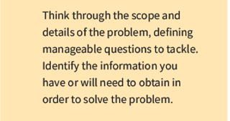
Computational Thinking
digitalpromise.org
ComputerBasedMath
Virus
Transmission
Incubation
Computational thinking is the thought processes involved in formulating problems and their solutions so that the solutions are represented in a form that can be effectively carried out by an information-processing agent
Jeannette Wing, 2006

Slide 7
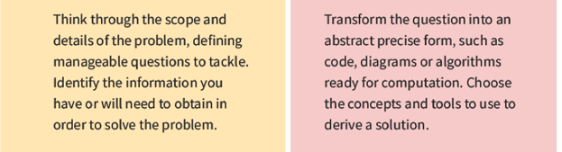
Computational Thinking
digitalpromise.org
ComputerBasedMath
Virus
Transmission
Incubation
Data
Contact tracing
Bio-Stat
models
Computational thinking is the thought processes involved in formulating problems and their solutions so that the solutions are represented in a form that can be effectively carried out by an information-processing agent
Jeannette Wing, 2006

Slide 8
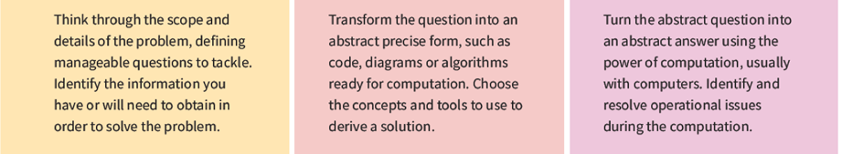
Computational Thinking
digitalpromise.org
ComputerBasedMath
Virus
Transmission
Incubation
Data
Contact tracing
Bio-Stat
models
Computational thinking is the thought processes involved in formulating problems and their solutions so that the solutions are represented in a form that can be effectively carried out by an information-processing agent
Jeannette Wing, 2006
Transmission
prediction

Slide 9
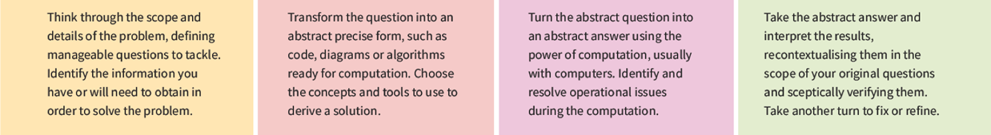
Computational Thinking
digitalpromise.org
ComputerBasedMath
Actions
Quarantine
Relaxation
Vaccination
Modifications
Model
Testing
Tracing
Virus
Transmission
Incubation
Data
Contact tracing
Bio-Stat
models
Computational thinking is the thought processes involved in formulating problems and their solutions so that the solutions are represented in a form that can be effectively carried out by an information-processing agent
Jeannette Wing, 2006
Transmission
prediction

Slide 10


www.slo.nl/vakportalen/vakportaal-digitale-geletterdheid/computational-thinking
Computational thinking is the process-based (re)formulating of problems in such a way that it becomes possible to solve the problem with computer technology. It concerns of thought processes in which problem formulation, data analysis and representation are used to solve problems using ICT techniques and tools.

Slide 11
www.slo.nl/vakportalen/vakportaal-digitale-geletterdheid/computational-thinking
Computational thinking is the process-based (re)formulating of problems in such a way that it becomes possible to solve the problem with computer technology. It concerns of thought processes in which problem formulation, data analysis and representation are used to solve problems using ICT techniques and tools.
……
The use of computer technology for solving problems needs understanding of algorithms - a series of instructions to achieve a specific goal - and procedures - a collection of activities to be performed in a specific order.

Slide 12
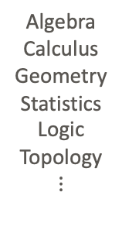
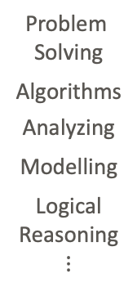

Mathematics & Computational Thinking …
Mathematics
Computational Thinking
Problem
Solving
Algorithms
Analyzing
Modelling
Logical
Reasoning
$$⋮$$
Algebra
Calculus
Geometry
Statistics
Logic
Topology
$$⋮$$
Simulation
Data Collection
Data Mining
Robotics
Networking
Programming
$$⋮$$

Slide 13


Mathematics & Computational Thinking …
Mathematics
Computational Thinking
Problem
Solving
Algorithms
Analyzing
Modelling
Logical
Reasoning
$$⋮$$
Algebra
Calculus
Geometry
Statistics
Logic
Topology
$$⋮$$
Simulation
Data Collection
Data Mining
Robotics
Networking
Programming
$$⋮$$
… in the
classroom
Available in the classroom
One user interface
Different platforms: HH & SW
Popular high level programming language
Accessible and easy to read
WW community for all levels

Slide 14
Computational Thinking
in the classroom
Structure
Translate
Process
Control

Slide 15
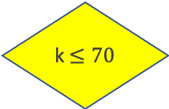
Computational Thinking
in the classroom
Structure
Translate
Process
Control
Structure
k = # kilometers
k $≤70$
No
Price
€ 66 + 0,30(k-70)
Yes
Price € 66

Slide 16
Computational Thinking
in the classroom
Structure
Translate
Process
Control
Structure
Translate
k = # kilometers
Input
k $≤70$
No
Price
€ 66 + 0,30(k-70)
Calculation
Yes
Output
Price € 66

Slide 17
Computational Thinking
in the classroom
Structure
Translate
Process
Control
Structure
Translate
Process
k = # kilometers
Input
k $≤70$
No
Price
€ 66 + 0,30(k-70)
Calculation
Yes
Output
Price € 66

Slide 18
Computational Thinking
in the classroom
Structure
Translate
Process
Control
Control
Structure
Translate
Process
k = # kilometers
Input
k $≤70$
No
Price
€ 66 + 0,30(k-70)
Calculation
Yes
Output
Price € 66

Slide 19
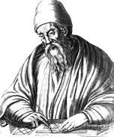
Computational Thinking
in the classroom
Euclides
The GCD of two integers is equal to the GCD of the smallest number and the remainder of the division of the largest number by the smallest.
Two integers
Subtract the smallest as often as possible from the largest one
Replace the largest integer by the result of the substractions
no
Is the result equal to 0?
yes
kleinste = ggd

Slide 20
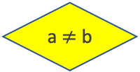
Computational Thinking
in the classroom
Euclides
The GCD of two integers is equal to the GCD of the smallest number and the remainder of the division of the largest number by the smallest.
Input a,b
no
a $≠$ b
Two integers
yes
no
a > b
Subtract the smallest as often as possible from the largest one
Replace the largest integer by the result of the substractions
yes
no
a = a - b
Is the result equal to 0?
yes
kleinste = ggd
b = b - a
Print a

Slide 21
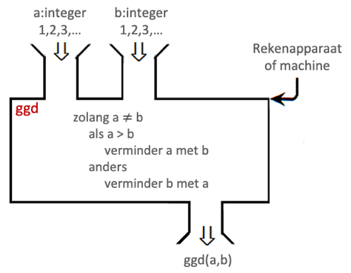
Computational Thinking
in the classroom
Euclides
The GCD of two integers is equal to the GCD of the smallest number and the remainder of the division of the largest number by the smallest.
Input a,b
a: integer
1,2,3,…
b: integer
1,2,3,…
Calculator or computer
no
a $≠$ b
gcd
as long as a ≠ b
if a> b
subtract b from a
else
subtract a from b
Two integers
yes
no
a > b
Subtract the smallest as often as possible from the largest one
Replace the largest integer by the result of the substractions
gcd(a,b)
yes
no
a = a - b
Is the result equal to 0?
yes
kleinste = ggd
b = b - a
Print a

Slide 22
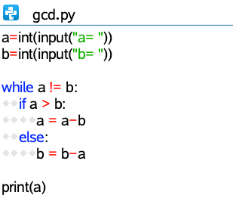
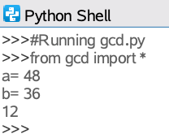
Computational Thinking
in the classroom
Euclides
The GCD of two integers is equal to the GCD of the smallest number and the remainder of the division of the largest number by the smallest.
Input a,b
a: integer
1,2,3,…
b: integer
1,2,3,…
Calculator or computer
no
a $≠$ b
gcd
as long as a ≠ b
if a> b
subtract b from a
else
subtract a from b
Two integers
yes
no
a > b
Subtract the smallest as often as possible from the largest one
Replace the largest integer by the result of the substractions
gcd(a,b)
yes
no
a = a - b
Is the result equal to 0?
yes
kleinste = ggd
b = b - a
Print a

Slide 23
Computational Thinking
in the classroom
Euclides
gcd(1140,900)
gcd(900,240)
gcd(240,180)
gcd(180,60)
gcd(60,0)
1140
900
240
180
=
=
=
=
1
3
1
3
x
x
x
x
900
240
180
60
+
+
+
+
240
180
60
0
The GCD of two integers is equal to the GCD of the smallest number and the remainder of the division of the largest number by the smallest.
=
=
=
Two integers a, b
=
= 60
Determine the remainder r of the division of a by b
Replace a by b
and b by r
Is r = 0?
no
yes
b = gcd

Slide 24
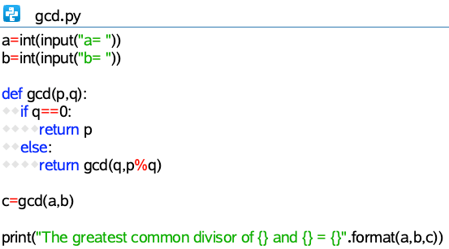
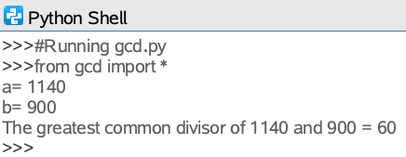
Computational Thinking
in the classroom
Euclides
gcd(1140,900)
gcd(900,240)
gcd(240,180)
gcd(180,60)
gcd(60,0)
1140
900
240
180
=
=
=
=
1
3
1
3
x
x
x
x
900
240
180
60
+
+
+
+
240
180
60
0
The GCD of two integers is equal to the GCD of the smallest number and the remainder of the division of the largest number by the smallest.
=
=
=
Two integers a, b
=
= 60
Determine the remainder r of the division of a by b
Replace a by b
and b by r
Recursion
Is r = 0?
no
yes
b = gcd

Slide 25
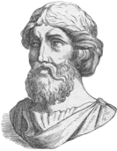
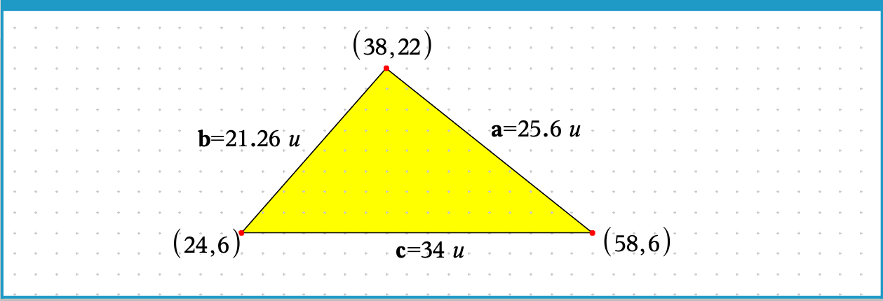
Computational Thinking
Pythagoras
in the
classroom

Slide 26
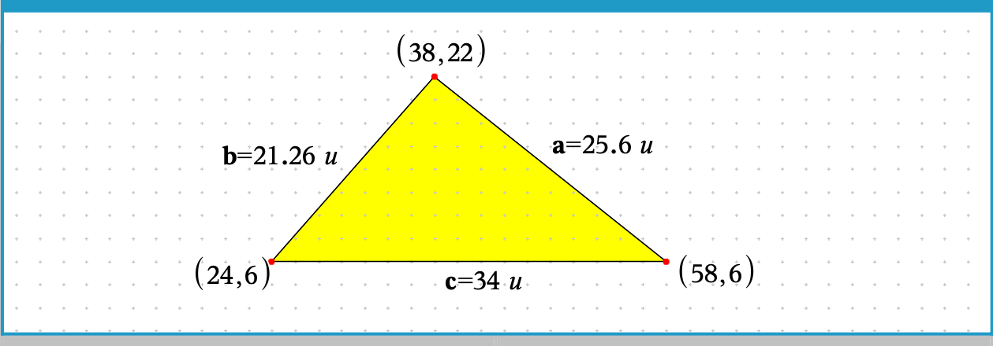
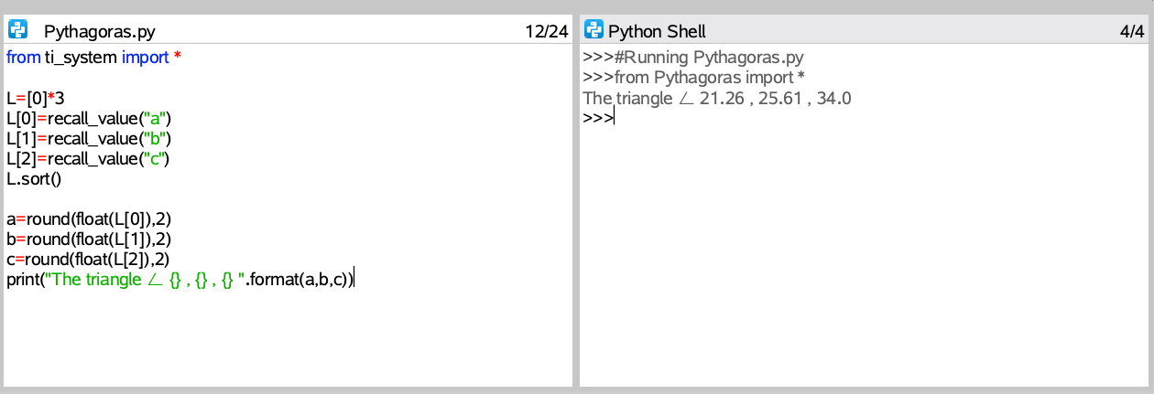
Computational Thinking
Pythagoras
in the
classroom
Exchange variables

Slide 27
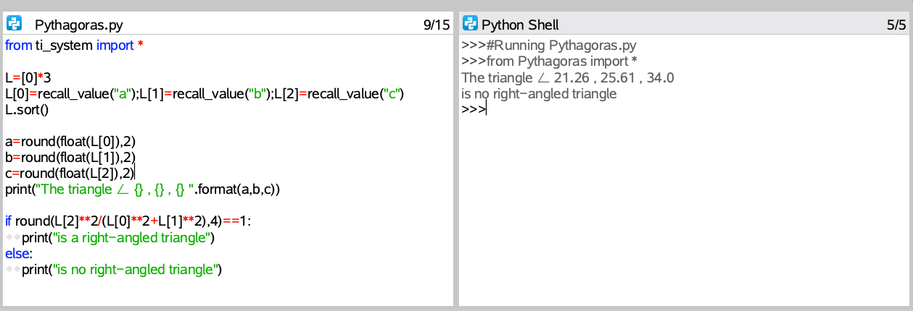
Computational Thinking
Pythagoras
in the
classroom

Slide 28
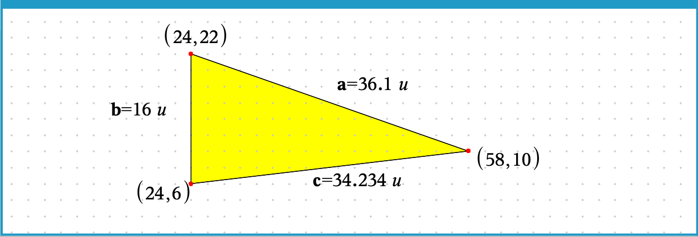

Computational Thinking
Pythagoras
in the
classroom

Slide 29
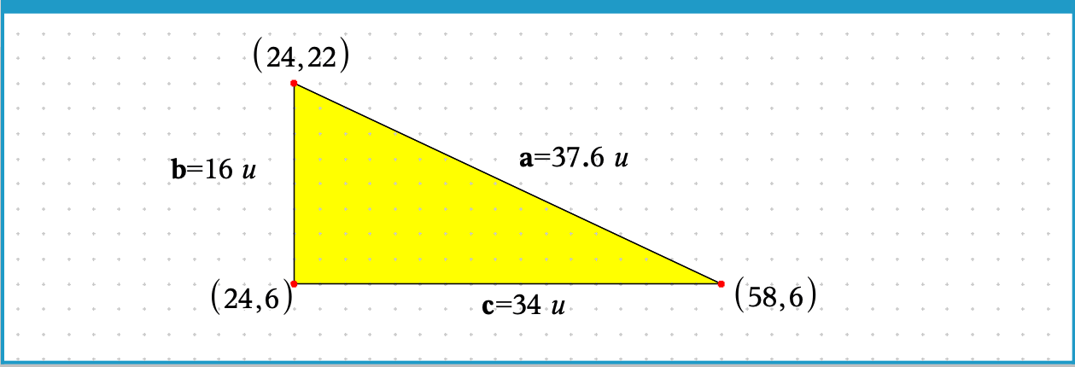

Computational Thinking
Pythagoras
in the
classroom

Slide 30
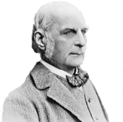
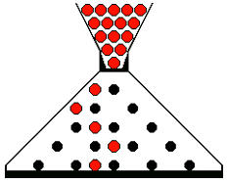
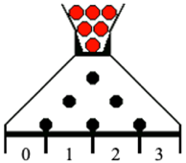
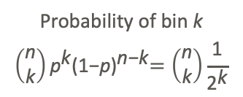
Computational Thinking
in the classroom
Galton
Bean Machine
Galton Board
n rows of pegs
Probability
Distrubution
B(n,½)
Probability of bin k
$$\left(\begin{matrix}\text{n} \\ \text{k}\end{matrix}\right){\text{p}}^{\text{k}}{\text{(1}\text{−}\text{p}\text{)}}^{\text{n}\text{−}\text{k}}=\left(\begin{matrix}\text{n} \\ \text{k}\end{matrix}\right)\frac{\text{1}}{{\text{2}}^{\text{k}}}$$
LLL
LLR
LRL
RLL
RRL
RLR
LRR
RRR

Slide 31
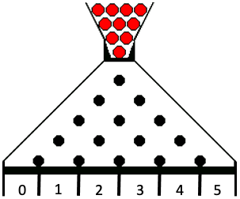
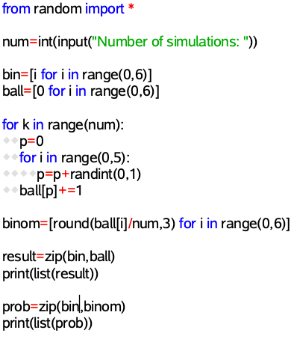

Computational Thinking
in the classroom
Galton
Bean Machine
Galton Board
n rows of pegs
Probability
Distrubution
B(n,½)
Probability of bin k
$$\left(\begin{matrix}\text{n} \\ \text{k}\end{matrix}\right){\text{p}}^{\text{k}}{\text{(1}\text{−}\text{p}\text{)}}^{\text{n}\text{−}\text{k}}=\left(\begin{matrix}\text{n} \\ \text{k}\end{matrix}\right)\frac{\text{1}}{{\text{2}}^{\text{k}}}$$
LLL
LLR
LRL
RLL
RRL
RLR
LRR
RRR

Slide 32
Computational Thinking
in the classroom
Galton
Bean Machine
Galton Board
n rows of pegs
Probability
Distrubution
B(n,½)
Probability of bin k
$$\left(\begin{matrix}\text{n} \\ \text{k}\end{matrix}\right){\text{p}}^{\text{k}}{\text{(1}\text{−}\text{p}\text{)}}^{\text{n}\text{−}\text{k}}=\left(\begin{matrix}\text{n} \\ \text{k}\end{matrix}\right)\frac{\text{1}}{{\text{2}}^{\text{k}}}$$
LLL
LLR
LRL
RLL
RRL
RLR
LRR
RRR

Slide 33
Computational Thinking
in the classroom
Galton
Bean Machine
Galton Board
n rows of pegs
Probability
Distrubution
B(n,½)
Probability of bin k
$$\left(\begin{matrix}\text{n} \\ \text{k}\end{matrix}\right){\text{p}}^{\text{k}}{\text{(1}\text{−}\text{p}\text{)}}^{\text{n}\text{−}\text{k}}=\left(\begin{matrix}\text{n} \\ \text{k}\end{matrix}\right)\frac{\text{1}}{{\text{2}}^{\text{k}}}$$
LLL
LLR
LRL
RLL
RRL
RLR
LRR
RRR

Slide 34
Computational Thinking
in the classroom
Galton
Bean Machine
Galton Board
n rows of pegs
Probability
Distrubution
B(n,½)
Probability of bin k
$$\left(\begin{matrix}\text{n} \\ \text{k}\end{matrix}\right){\text{p}}^{\text{k}}{\text{(1}\text{−}\text{p}\text{)}}^{\text{n}\text{−}\text{k}}=\left(\begin{matrix}\text{n} \\ \text{k}\end{matrix}\right)\frac{\text{1}}{{\text{2}}^{\text{k}}}$$
LLL
LLR
LRL
RLL
RRL
RLR
LRR
RRR

Slide 35
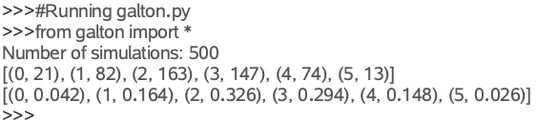
Computational Thinking
in the classroom
Galton
Bean Machine
Galton Board
n rows of pegs
Probability
Distrubution
B(n,½)
Probability of bin k
$$\left(\begin{matrix}\text{n} \\ \text{k}\end{matrix}\right){\text{p}}^{\text{k}}{\text{(1}\text{−}\text{p}\text{)}}^{\text{n}\text{−}\text{k}}=\left(\begin{matrix}\text{n} \\ \text{k}\end{matrix}\right)\frac{\text{1}}{{\text{2}}^{\text{k}}}$$
LLL
LLR
LRL
RLL
RRL
RLR
LRR
RRR

Slide 36

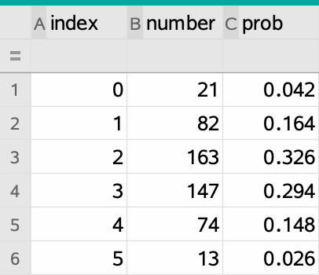
Computational Thinking
in the classroom
Galton
Bean Machine
Galton Board
n rows of pegs
Probability
Distrubution
B(n,½)
Probability of bin k
$$\left(\begin{matrix}\text{n} \\ \text{k}\end{matrix}\right){\text{p}}^{\text{k}}{\text{(1}\text{−}\text{p}\text{)}}^{\text{n}\text{−}\text{k}}=\left(\begin{matrix}\text{n} \\ \text{k}\end{matrix}\right)\frac{\text{1}}{{\text{2}}^{\text{k}}}$$
LLL
LLR
LRL
RLL
RRL
RLR
LRR
RRR

Slide 37
Computational Thinking
in the classroom
Galton
Bean Machine
Galton Board
n rows of pegs
Probability
Distrubution
B(n,½)
Probability of bin k
$$\left(\begin{matrix}\text{n} \\ \text{k}\end{matrix}\right){\text{p}}^{\text{k}}{\text{(1}\text{−}\text{p}\text{)}}^{\text{n}\text{−}\text{k}}=\left(\begin{matrix}\text{n} \\ \text{k}\end{matrix}\right)\frac{\text{1}}{{\text{2}}^{\text{k}}}$$
LLL
LLR
LRL
RLL
RRL
RLR
LRR
RRR

Slide 38
Computational Thinking
in the classroom
Galton
Graphical Python Modules
Bean Machine
Galton Board
n rows of pegs
Probability
Distrubution
B(n,½)
Probability of bin k
$$\left(\begin{matrix}\text{n} \\ \text{k}\end{matrix}\right){\text{p}}^{\text{k}}{\text{(1}\text{−}\text{p}\text{)}}^{\text{n}\text{−}\text{k}}=\left(\begin{matrix}\text{n} \\ \text{k}\end{matrix}\right)\frac{\text{1}}{{\text{2}}^{\text{k}}}$$
LLL
LLR
LRL
RLL
RRL
RLR
LRR
RRR

Slide 39
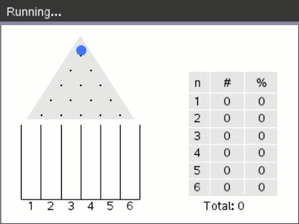
Computational Thinking
in the classroom
Galton
Graphical Python Modules
Bean Machine
Galton Board
n rows of pegs
Probability
Distrubution
B(n,½)
Probability of bin k
$$\left(\begin{matrix}\text{n} \\ \text{k}\end{matrix}\right){\text{p}}^{\text{k}}{\text{(1}\text{−}\text{p}\text{)}}^{\text{n}\text{−}\text{k}}=\left(\begin{matrix}\text{n} \\ \text{k}\end{matrix}\right)\frac{\text{1}}{{\text{2}}^{\text{k}}}$$
LLL
LLR
LRL
RLL
RRL
RLR
LRR
RRR

Slide 40
Computational Thinking
in the classroom
K-means
clustering
Standard Algorithm
Step 1
Determine the number of clusters , K.
Step 2
Choose the postion of the cluster centers
c₁ , c₂ , … , c_{K.}
# clusters (2…5):

Slide 41
Computational Thinking
in the classroom
K-means
clustering
Standard Algorithm
Step 1
Determine the number of clusters , K.
Step 2
Choose the postion of the cluster centers
c₁ , c₂ , … , c_{K.}
Step 3
  Determine for each point the nearest center and assign the punt to the corresponding cluster.
  Determine for each cluster a new center, the mean or the center of gravity of the cluster.
# clusters (2…5):

Slide 42
Computational Thinking
in the classroom
K-means
clustering
Standard Algorithm
Step 1
Determine the number of clusters , K.
Step 2
Choose the postion of the cluster centers
c₁ , c₂ , … , c_{K.}
Step 3
  Determine for each point the nearest center and assign the punt to the corresponding cluster.
  Determine for each cluster a new center, the mean or the center of gravity of the cluster.
Step 4
Repeat Step 3 until the cluster centers don’t change anymore.
# clusters (2…5):

Slide 43
Computational Thinking
in the classroom
K-means
clustering
Standard Algorithm
Step 1
Determine the number of clusters , K.
Step 2
Choose the postion of the cluster centers
c₁ , c₂ , … , c_{K.}
Step 3
  Determine for each point the nearest center and assign the punt to the corresponding cluster.
  Determine for each cluster a new center, the mean or the center of gravity of the cluster.
Step 4
Repeat Step 3 until the cluster centers don’t change anymore.
# clusters (2…5):

Slide 44
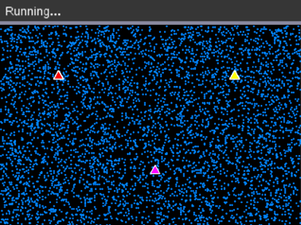
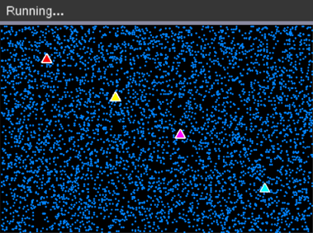
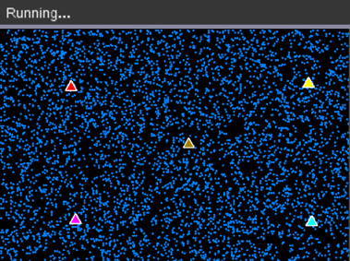
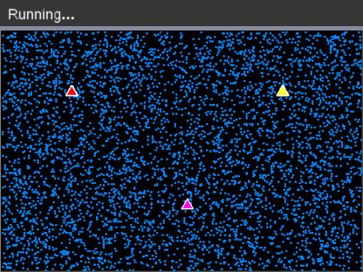
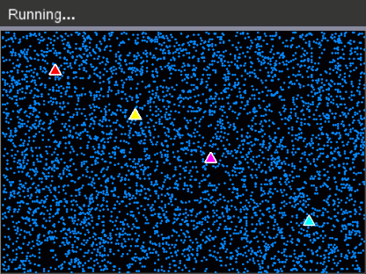
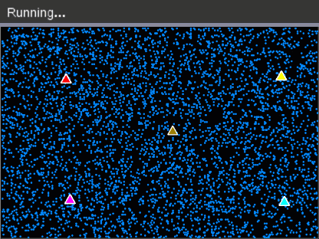
Computational Thinking
in the classroom
K-means
clustering
Standard Algorithm
points=[]
random_data(n)
number_clusters()
choose_center()
while get_key() != "esc":
♦♦background(black)
♦♦generate_clusters()
♦♦draw_points()
♦♦draw_centers()
♦♦paint_buffer()
♦♦update_centers()
3 Clusters
4 Clusters
5 Clusters
Voronoi-diagrams

Slide 45
Computational Thinking
in the classroom
Graphical
Patterns
from ti_draw import *
for r in range(30,0,-5):
♦♦set_color(255,255,255)
♦♦fill_circle(159,106,r)
♦♦set_color(0,0,0)
♦♦draw_circle(i,j,r)

Slide 46
Computational Thinking
in the classroom
Graphical
Patterns
from ti_draw import *
for i in range(0,318,60):
♦♦for r in range(30,0,-5):
♦♦♦♦set_color(255,255,255)
♦♦♦♦fill_circle(i,106,r)
♦♦♦♦set_color(0,0,0)
♦♦♦♦draw_circle(i,106,r)

Slide 47
Computational Thinking
in the classroom
Graphical
Patterns
from ti_draw import *
for j in range(0,212,60):
♦♦for i in range(0,318,60):
♦♦ ♦♦for r in range(30,0,-5):
♦♦♦♦♦♦set_color(255,255,255)
♦♦♦♦♦♦fill_circle(i,j,r)
♦♦♦♦♦♦set_color(0,0,0)
♦♦♦♦♦♦draw_circle(i,j,r)

Slide 48
Computational Thinking
in the classroom
Graphical
Patterns
from ti_draw import *
for j in range(0,212,30):
♦♦for i in range(0,318,60):
♦♦ ♦♦for r in range(30,0,-5):
♦♦♦♦♦♦set_color(255,255,255)
♦♦♦♦♦♦fill_circle(i,j,r)
♦♦♦♦♦♦set_color(0,0,0)
♦♦♦♦♦♦draw_circle(i,j,r)

Slide 49
Computational Thinking
in the classroom
Graphical
Patterns
from ti_draw import *
for j in range(0,212,15):
♦♦for i in range(0,318,60):
♦♦ ♦♦for r in range(30,0,-5):
♦♦♦♦♦♦set_color(255,255,255)
♦♦♦♦♦♦fill_circle(i,j,r)
♦♦♦♦♦♦set_color(0,0,0)
♦♦♦♦♦♦draw_circle(i,j,r)

Slide 50
Computational Thinking
in the classroom
Graphical
Patterns
from ti_draw import *
for j in range(0,212,15):
♦♦ for i in range(0,318,60):
♦♦♦♦x=30*((j/15)%2)
♦♦♦♦for r in range(30,0,-5):
♦♦♦♦♦♦set_color(255,255,255)
♦♦♦♦♦♦ fill_circle(i+x,j,r)
♦♦♦♦♦♦set_color(0,0,0)
♦♦♦♦♦♦draw_circle(i+x,j,r)

Slide 51
Computational Thinking
in the classroom
Graphical
Patterns
from ti_draw import *
for j in range(0,212,15):
♦♦ for i in range(0,318,60):
♦♦♦♦x=30*((j/15)%2)
♦♦♦♦for r in range(30,0,-5):
# set_color(255,255,255)
# fill_circle(i+x,j,r)
♦♦♦♦♦♦set_color(0,0,0)
♦♦♦♦♦♦draw_circle(i+x,j,r)

Slide 52
Computational Thinking
in the classroom
Graphical
Patterns
from ti_draw import *
for j in range(0,212,15):
♦♦ for i in range(0,318,60):
♦♦♦♦x=30*((j/15)%2)
♦♦♦♦for r in range(30,0,-5):
♦♦♦♦♦♦set_color(75+6*r,75+6*r,75+6*r)
♦♦♦♦♦♦fill_circle(i+x,j,r)
♦♦♦♦♦♦set_color(0,0,0)
♦♦♦♦♦♦draw_circle(i+x,j,r)

Slide 53
Computational Thinking
in the classroom
Graphical
Patterns
from ti_draw import *
red=(255,0,0)
green=(0,255,0)
blue=(0,0,255)
yellow=(255,255,0)
cyan=(0,255,255)
magenta=(255,0,255)
color=[red,yellow,green,cyan,magenta,blue]
k=0
for j in range(0,212,15):
♦♦ for i in range(0,318,60):
♦♦♦♦x=30*((j/15)%2)
♦♦♦♦for r in range(30,0,-5):
♦♦♦♦♦♦set_color(color[k])
♦♦♦♦♦♦k=(k+1)%6
♦♦♦♦♦♦fill_circle(i+x,j,r)
♦♦♦♦♦♦set_color(0,0,0)
♦♦♦♦♦♦draw_circle(i+x,j,r)

Slide 54
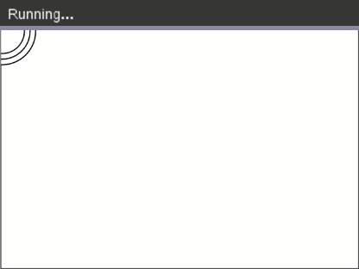
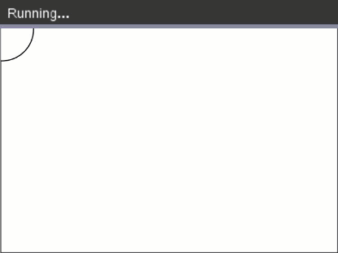
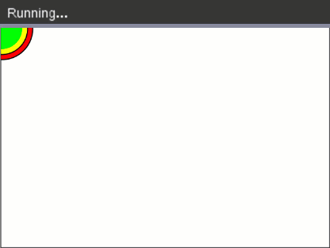
Computational Thinking
in the classroom
Graphical
Patterns
from ti_draw import *
red=(255,0,0)
green=(0,255,0)
blue=(0,0,255)
yellow=(255,255,0)
cyan=(0,255,255)
magenta=(255,0,255)
color=[red,yellow,green,cyan,magenta,blue]
k=0
for j in range(0,212,15):
♦♦ for i in range(0,318,60):
♦♦♦♦x=30*((j/15)%2)
♦♦♦♦for r in range(30,0,-5):
♦♦♦♦♦♦set_color(color[k])
♦♦♦♦♦♦k=(k+1)%6
♦♦♦♦♦♦fill_circle(i+x,j,r)
♦♦♦♦♦♦set_color(0,0,0)
♦♦♦♦♦♦draw_circle(i+x,j,r)

Slide 55
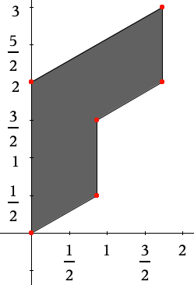
Computational Thinking
in the classroom
Tiles
Tessellation
from ti_draw import *
from math import sqrt
black=(0,0,0)
gray=(200,200,200)
f=0.5*sqrt(3)
def tile(x,y,color,orientation):
♦♦px=[0,f,f,2*f,2*f,0,0]
♦♦py=[0,0.5,1.5,2,3,2,0]
♦♦for i in range(7):
♦♦♦♦px[i]=x+16*px[i]*orientation
♦♦♦♦py[i]=y-16*py[i]
♦♦♦♦set_color(color)
♦♦♦♦fill_poly(px,py)
py
px

Slide 56
Computational Thinking
in the classroom
Tiles
Tessellation
from ti_draw import *
from math import sqrt
black=(0,0,0)
gray=(200,200,200)
f=0.5*sqrt(3)
def tile(x,y,color,orientation):
♦♦px=[0,f,f,2*f,2*f,0,0]
♦♦py=[0,0.5,1.5,2,3,2,0]
♦♦for i in range(7):
♦♦♦♦px[i]=x+16*px[i]*orientation
♦♦♦♦py[i]=y-16*py[i]
♦♦♦♦set_color(color)
♦♦♦♦fill_poly(px,py)
♦♦tile(159,102,black,1)
♦♦tile(159,102,gray,-1)

Slide 57
Computational Thinking
in the classroom
Tiles
Tessellation
from ti_draw import *
from math import sqrt
black=(0,0,0)
gray=(200,200,200)
f=0.5*sqrt(3)
def tile(x,y,color,orientation):
♦♦px=[0,f,f,2*f,2*f,0,0]
♦♦py=[0,0.5,1.5,2,3,2,0]
♦♦for i in range(7):
♦♦♦♦px[i]=x+16*px[i]*orientation
♦♦♦♦py[i]=y-16*py[i]
♦♦♦♦set_color(color)
♦♦♦♦fill_poly(px,py)
for i in range(10):
♦♦x=48*f*i
♦♦tile(x,102,black,1)
♦♦tile(x,102,gray,-1)

Slide 58
Computational Thinking
in the classroom
Tiles
Tessellation
from ti_draw import *
from math import sqrt
black=(0,0,0)
gray=(200,200,200)
f=0.5*sqrt(3)
def tile(x,y,color,orientation):
♦♦px=[0,f,f,2*f,2*f,0,0]
♦♦py=[0,0.5,1.5,2,3,2,0]
♦♦for i in range(7):
♦♦♦♦px[i]=x+16*px[i]*orientation
♦♦♦♦py[i]=y-16*py[i]
♦♦♦♦set_color(color)
♦♦♦♦fill_poly(px,py)
for i in range(10):
♦♦x=48*f*i
♦♦if i%2==0:
♦♦♦♦y=102
♦♦else:
♦♦♦♦y=102-24
♦♦tegel(x,y,black,1)
♦♦tegel(x,y,gray,-1)

Slide 59
Computational Thinking
in the classroom
Tiles
Tessellation
from ti_draw import *
from math import sqrt
black=(0,0,0)
gray=(200,200,200)
f=0.5*sqrt(3)
def tile(x,y,color,orientation):
♦♦px=[0,f,f,2*f,2*f,0,0]
♦♦py=[0,0.5,1.5,2,3,2,0]
♦♦for i in range(7):
♦♦♦♦px[i]=x+16*px[i]*orientation
♦♦♦♦py[i]=y-16*py[i]
♦♦♦♦set_color(color)
♦♦♦♦fill_poly(px,py)
for i in range(10):
♦♦x=48*f*i
♦♦if i%2==0:
♦♦♦♦y=102
♦♦else:
♦♦♦♦y=102-24
♦♦tile(x,y,black,1)
♦♦tile(x,y,gray,-1)
for i in range(10):
♦♦x=48*f*i
♦♦if i%2==0:
♦♦♦♦y=150
♦♦else:
♦♦♦♦y=150-24
♦♦tile(x,y,black,1)
♦♦tile(x,y,gray,-1)

Slide 60
Computational Thinking
in the classroom
Tiles
Tessellation
from ti_draw import *
from math import sqrt
black=(0,0,0)
gray=(200,200,200)
f=0.5*sqrt(3)
def tile(x,y,color,orientation):
♦♦px=[0,f,f,2*f,2*f,0,0]
♦♦py=[0,0.5,1.5,2,3,2,0]
♦♦for i in range(7):
♦♦♦♦px[i]=x+16*px[i]*orientation
♦♦♦♦py[i]=y-16*py[i]
♦♦♦♦set_color(color)
♦♦♦♦fill_poly(px,py)
for i in range(10):
♦♦for j in range(6):
♦♦♦♦x=48*f*I
♦♦♦♦if i%2==0:
♦♦♦♦♦♦y=48*j
♦♦♦♦else:
♦♦♦♦♦♦y=48*j -24
♦♦♦♦tile(x,y,black,1)
♦♦♦♦tile(x,y,gray,-1)

Slide 61
Computational Thinking
in the classroom
Tiles
Tessellation
from ti_draw import *
from math import sqrt
black=(0,0,0)
gray=(200,200,200)
f=0.5*sqrt(3)
def tile(x,y,color,orientation):
♦♦px=[0,f,f,2*f,2*f,0,0]
♦♦py=[0,0.5,1.5,2,3,2,0]
♦♦for i in range(7):
♦♦♦♦px[i]=x+16*px[i]*orientation
♦♦♦♦py[i]=y-16*py[i]
♦♦♦♦set_color(color)
♦♦♦♦fill_poly(px,py)
for i in range(10):
♦♦for j in range(6):
♦♦♦♦x=48*f*I
♦♦♦♦if i%2==0:
♦♦♦♦♦♦y=48*j
♦♦♦♦else:
♦♦♦♦♦♦y=48*j -24
♦♦♦♦tile(x,y,black,1)
♦♦♦♦tile(x,y,gray,-1)
red=(255,0,0)
blue=(0,0,255)
tile(x,y,blue,1)
tile(x,y,red,-1)

Slide 62
Computational Thinking
in the classroom
Tiles
Tessellation
from ti_draw import *
from math import sqrt
black=(0,0,0)
gray=(200,200,200)
f=0.5*sqrt(3)
def tile(x,y,color,orientation):
♦♦px=[0,f,f,2*f,2*f,0,0]
♦♦py=[0,0.5,1.5,2,3,2,0]
♦♦for i in range(7):
♦♦♦♦px[i]=x+16*px[i]*orientation
♦♦♦♦py[i]=y-16*py[i]
♦♦♦♦set_color(color)
♦♦♦♦fill_poly(px,py)
for i in range(10):
♦♦for j in range(6):
♦♦♦♦x=48*f*I
♦♦♦♦if i%2==0:
♦♦♦♦♦♦y=48*j
♦♦♦♦else:
♦♦♦♦♦♦y=48*j -24
♦♦♦♦tile(x,y,black,1)
♦♦♦♦tile(x,y,gray,-1)
red=(255,0,0)
blue=(0,0,255)
tile(x,y,blue,1)
tile(x,y,red,-1)
yellow=(255,255,0)
set_color(yellow)
fill_rect(0,0,318,212)

Slide 63
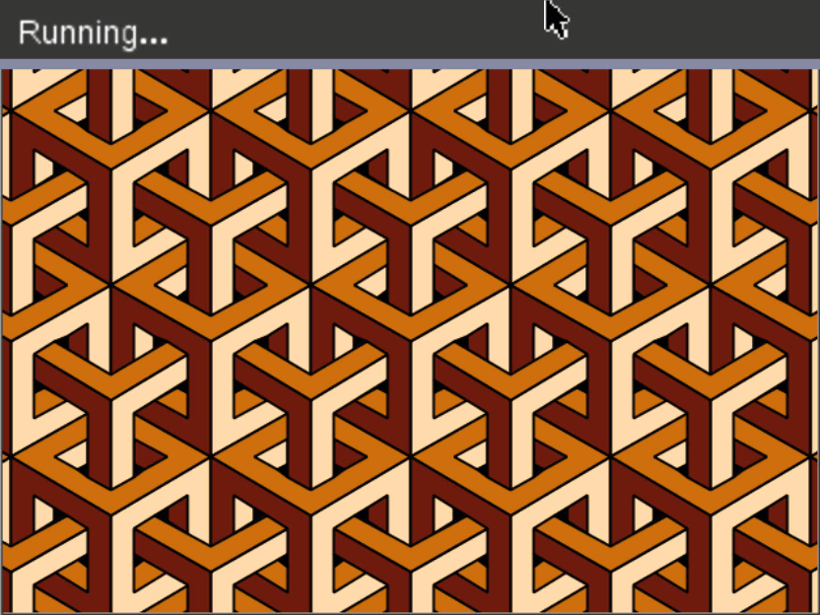
Computational Thinking
in the classroom
Tiles
Tessellation
from ti_draw import *
from math import sqrt
black=(0,0,0)
gray=(200,200,200)
f=0.5*sqrt(3)
def tile(x,y,color,orientation):
♦♦px=[0,f,f,2*f,2*f,0,0]
♦♦py=[0,0.5,1.5,2,3,2,0]
♦♦for i in range(7):
♦♦♦♦px[i]=x+16*px[i]*orientation
♦♦♦♦py[i]=y-16*py[i]
♦♦♦♦set_color(color)
♦♦♦♦fill_poly(px,py)
for i in range(10):
♦♦for j in range(6):
♦♦♦♦x=48*f*I
♦♦♦♦if i%2==0:
♦♦♦♦♦♦y=48*j
♦♦♦♦else:
♦♦♦♦♦♦y=48*j -24
♦♦♦♦tile(x,y,black,1)
♦♦♦♦tile(x,y,gray,-1)
red=(255,0,0)
blue=(0,0,255)
tile(x,y,blue,1)
tile(x,y,red,-1)
yellow=(255,255,0)
set_color(yellow)
fill_rect(0,0,318,212)

Slide 64
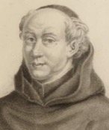
Computational Thinking
in the classroom
Truchet
Tiles

Slide 65
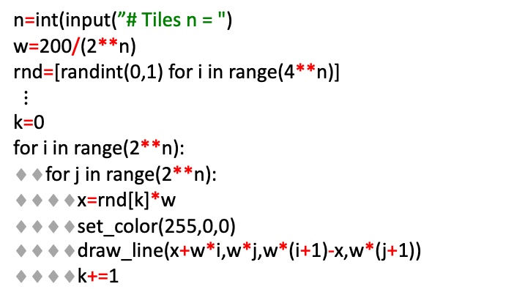
Computational Thinking
in the classroom
Truchet
Tiles
Diagonals – Labyrinth
The algorithm
n=0
n=1
n=2
n=int(input(”# Tiles n = ")
w=200/(2**n)
rnd=[randint(0,1) for i in range(4**n)]
$$⋮$$
k=0
for i in range(2**n):
♦♦for j in range(2**n):
♦♦♦♦x=rnd[k]*w
♦♦♦♦set_color(255,0,0)
♦♦♦♦draw_line(x+w*i,w*j,w*(i+1)-x,w*(j+1))
♦♦♦♦k+=1

Slide 66
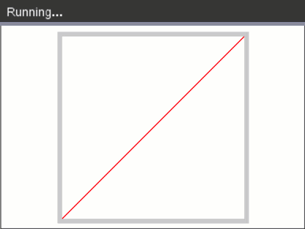
Computational Thinking
in the classroom
Truchet
Tiles
Diagonals – Labyrinth
The algorithm
n=0
n=1
n=2
n=int(input(”# Tiles n = ")
w=200/(2**n)
rnd=[randint(0,1) for i in range(4**n)]
$$⋮$$
k=0
for i in range(2**n):
♦♦for j in range(2**n):
♦♦♦♦x=rnd[k]*w
♦♦♦♦set_color(255,0,0)
♦♦♦♦draw_line(x+w*i,w*j,w*(i+1)-x,w*(j+1))
♦♦♦♦k+=1

Slide 67
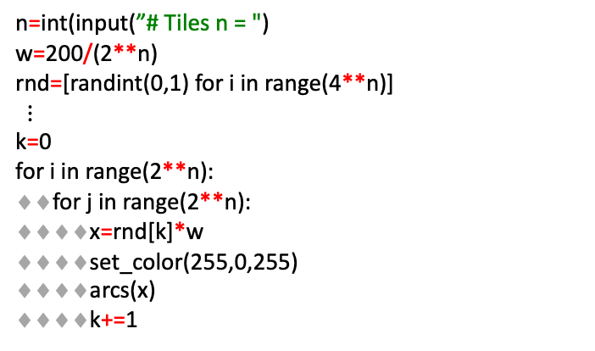
Computational Thinking
in the classroom
Truchet
Tiles
Circular Arcs Paths
The algorithm
n=1
n=2
def arcs(r):
♦♦if r==0:
♦♦♦♦x=(i-0.5)*w
♦♦♦♦y=(j-0.5)*w
♦♦♦♦draw_arc(x,y,w,w,0,90)
♦♦♦♦x=(i+0.5)*w
♦♦♦♦y=(j+0.5)*w
♦♦♦♦draw_arc(x,y,w,w,180,90)
♦♦else:
♦♦♦♦x=(i-0.5)*w
♦♦♦♦y=(j+0.5)*w
♦♦♦♦draw_arc(x,y,w,w,0,-90)
♦♦♦♦x=(i+0.5)*w
♦♦♦♦y=(j-0.5)*w
♦♦♦♦draw_arc(x,y,w,w,90,90)
n=0
n=int(input(”# Tiles n = ")
w=200/(2**n)
rnd=[randint(0,1) for i in range(4**n)]
$$⋮$$
k=0
for i in range(2**n):
♦♦for j in range(2**n):
♦♦♦♦x=rnd[k]*w
♦♦♦♦set_color(255,0,255)
♦♦♦♦arcs(x)
♦♦♦♦k+=1

Slide 68
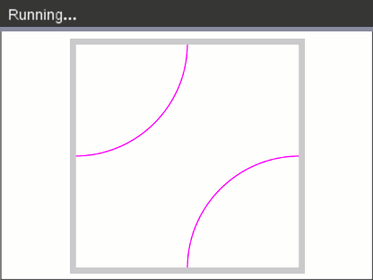

Computational Thinking
in the classroom
Truchet
Tiles
Circular Arcs Paths
The algorithm
n=1
n=2
def arcs(r):
♦♦if r==0:
♦♦♦♦x=(i-0.5)*w
♦♦♦♦y=(j-0.5)*w
♦♦♦♦draw_arc(x,y,w,w,0,90)
♦♦♦♦x=(i+0.5)*w
♦♦♦♦y=(j+0.5)*w
♦♦♦♦draw_arc(x,y,w,w,180,90)
♦♦else:
♦♦♦♦x=(i-0.5)*w
♦♦♦♦y=(j+0.5)*w
♦♦♦♦draw_arc(x,y,w,w,0,-90)
♦♦♦♦x=(i+0.5)*w
♦♦♦♦y=(j-0.5)*w
♦♦♦♦draw_arc(x,y,w,w,90,90)
n=0
n=int(input(”# Tiles n = ")
w=200/(2**n)
rnd=[randint(0,1) for i in range(4**n)]
$$⋮$$
k=0
for i in range(2**n):
♦♦for j in range(2**n):
♦♦♦♦x=rnd[k]*w
♦♦♦♦set_color(kleur)
♦♦♦♦boog(x)
♦♦♦♦k+=1

Slide 69
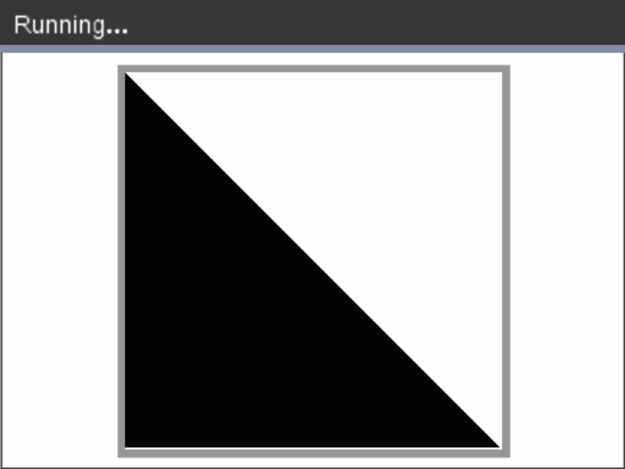
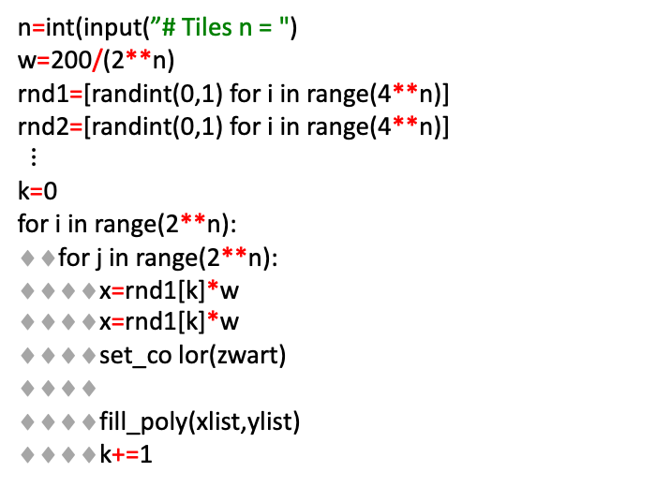
Computational Thinking
in the classroom
Truchet
Tiles
Truchet Tiles Patterns
The algorithm
n=int(input(”# Tiles n = ")
w=200/(2**n)
rnd1=[randint(0,1) for i in range(4**n)]
rnd2=[randint(0,1) for i in range(4**n)]
$$⋮$$
k=0
for i in range(2**n):
♦♦for j in range(2**n):
♦♦♦♦x=rnd1[k]*w
♦♦♦♦x=rnd1[k]*w
♦♦♦♦set_co lor(zwart)
♦♦♦♦
♦♦♦♦fill_poly(xlist,ylist)
♦♦♦♦k+=1
if x == 0:
♦♦if y==0:
♦♦♦♦xlist=[w*i,w*(i+1),w*(i+1),w*i]
♦♦♦♦ylist=[w*j,w*(j+1),w*j,w*j]
♦♦else:
♦♦♦♦xlist=[w*i,w*(i+1),w*i,w*i]
♦♦♦♦ylist=[w*j,w*(j+1),w*(j+1),w*j]
else:
♦♦if y==0:
♦♦♦♦xlist=[w*(i+1),w*i,w*i,w*(i+1)]
♦♦♦♦ylist=[w*j,w*(j+1),w*j,w*j]
♦♦else:
♦♦♦♦xlist=[w*(i+1),w*i,w*(i+1),w*(i+1)]
♦♦♦♦ylist=[w*j,w*(j+1),w*(j+1),w*j]

Slide 70



Computational Thinking
in the classroom
Screen
Saver
from ti_system import *
from ti_draw import *
from math import *
from time import *
black=(0,0,0)
color=(255,0,255)
set_window(-70,70,-70,70)
def curve1(t):
♦♦x=60*cos(t/10)
♦♦y=50*sin(t/20)
♦♦return (x,y)
def curve2(t):
♦♦x=75*cos(t/20)
♦♦y=75*sin(t/50)
♦♦return (x,y)
def background():
♦♦set_color(black)
♦♦fill_rect(-159,-106,318,212)

Slide 71
Computational Thinking
in the classroom
Screen
Saver
from ti_system import *
from ti_draw import *
from math import *
from time import *
black=(0,0,0)
color=(255,0,255)
set_window(-70,70,-70,70)
def curve1(t):
♦♦x=60*cos(t/10)
♦♦y=50*sin(t/20)
♦♦return (x,y)
def curve2(t):
♦♦x=75*cos(t/20)
♦♦y=75*sin(t/50)
♦♦return (x,y)
def background():
♦♦set_color(black)
♦♦fill_rect(-159,-106,318,212)
use_buffer()
t=0
while get_key() != "esc":
♦♦background()
♦♦set_color(color)
♦♦x1,y1=curve1(t)
♦♦x2,y2=curve2(t)
♦♦set_pen("medium","solid")
♦♦draw_line(x1,y1,x2,y2)
♦♦sleep(0.02)
♦♦paint_buffer()
♦♦t+=1

Slide 72

Computational Thinking
in the classroom
Screen
Saver
from ti_system import *
from ti_draw import *
from math import *
from time import *
black=(0,0,0)
color=(255,0,255)
set_window(-70,70,-70,70)
def curve1(t):
♦♦x=60*cos(t/10)
♦♦y=50*sin(t/20)
♦♦return (x,y)
def curve2(t):
♦♦x=75*cos(t/20)
♦♦y=75*sin(t/50)
♦♦return (x,y)
def background():
♦♦set_color(black)
♦♦fill_rect(-159,-106,318,212)
use_buffer()
t=0
while get_key() != "esc":
♦♦background()
♦♦set_color(color)
♦♦x1,y1=curve1(t)
♦♦x2,y2=curve2(t)
♦♦set_pen("medium","solid")
♦♦draw_line(x1,y1,x2,y2)
♦♦sleep(0.02)
♦♦paint_buffer()
♦♦t+=1

Slide 73

Computational Thinking
in the classroom
Screen
Saver
from ti_system import *
from ti_draw import *
from math import *
from time import *
black=(0,0,0)
color=(255,0,255)
set_window(-70,70,-70,70)
def curve1(t):
♦♦x=60*cos(t/10)
♦♦y=50*sin(t/20)
♦♦return (x,y)
def curve2(t):
♦♦x=75*cos(t/20)
♦♦y=75*sin(t/50)
♦♦return (x,y)
def background():
♦♦set_color(black)
♦♦fill_rect(-159,-106,318,212)
use_buffer()
t=0
while get_key() != "esc":
♦♦background()
♦♦set_color(color)
♦♦x1,y1=curve1(t)
♦♦x2,y2=curve2(t)
♦♦set_pen("medium","solid")
♦♦draw_line(x1,y1,x2,y2)
♦♦sleep(0.02)
♦♦paint_buffer()
♦♦t+=1
Same procedure
Multiple segments
Other curves
Multiple colors

Slide 74


Computational Thinking
with Python in the Math Classroom
Teaching is more than the dissemination of content
Teaching should cultivate curiosity and inquiry
Teaching should spark student imagination and creativity
Students
deserve it!
www.t3europe.eu
Some skills become more important because technology requires it
Some skills become less important because technology replaces it
Some skills becomes possible because technology allows it
based on Bert Waits - 2000

