Slide 1
Sharing Inspirations -2019 The Power of Realization

Slide 2
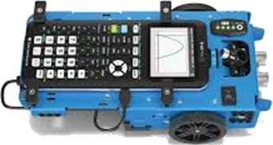
Let the ROVER the Learning
Sanjeev Meston
meston@meston.info

Slide 3
The Rover can Power and Drive learning in the classroom
The TI-Innovator Rover provides a great opportunity to strive for multi-dimensional STEM focused integrated learning.

Slide 4
This session will focus on
1. Analysing and understanding functions and graphs
2. Vectors 3. Physics of motion 4. Coding in TI basic Technology
TI-Nspire CX CAS
TI-Innovator Hub
TI-Innovator Rover
Prerequisites Familiarity with TI nspire CAS
(hand held or software)

Slide 5
Hashtag
#STEM,
#Coding,
#Programming,
#Mathematics,
#Physics,
#TI-Innovator,
# TI-Rover,
#CAS,
#TInspire

Slide 6
TI-Innovator™ Rover
The programmable robotic vehicle that drives conceptual curiosity in mathematics, science and coding.
TI-Innovator™ Hub is the centerpiece of the TI-Innovator™ Technology, a project kit that extends the functionality of Texas Instruments (TI) graphing calculators to make coding and engineering design accessible to students in the classroom.
Works with TI LaunchPad™ Board and other STEM accessories

Slide 7
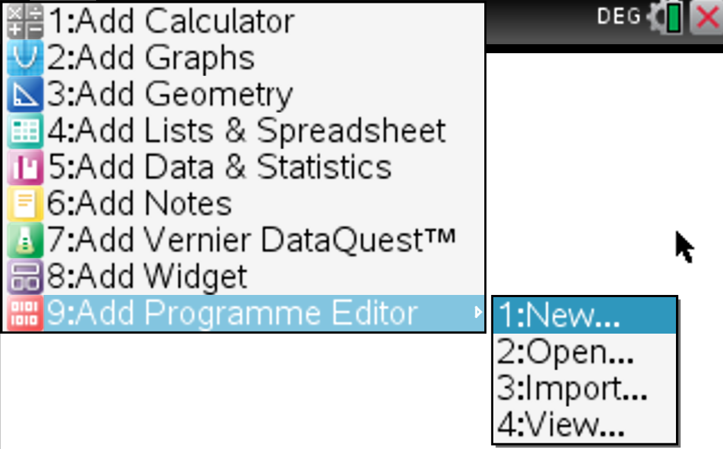

Slide 8
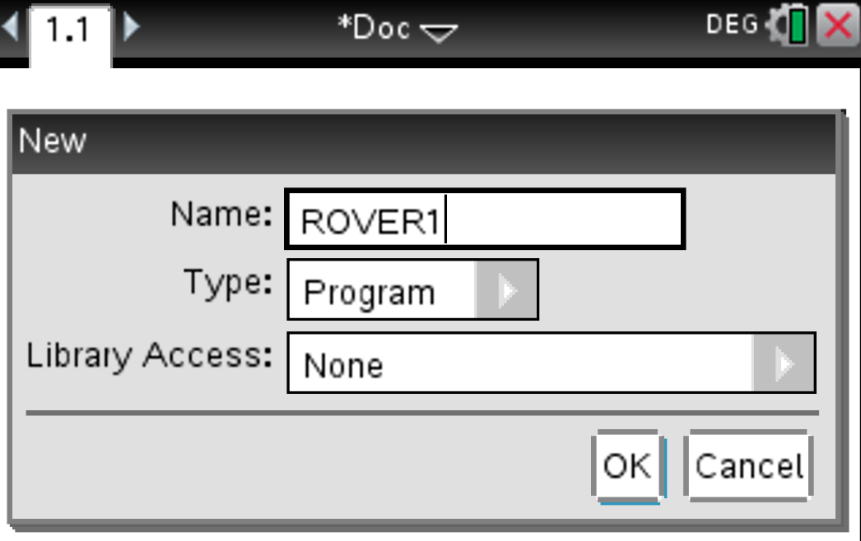

Slide 9
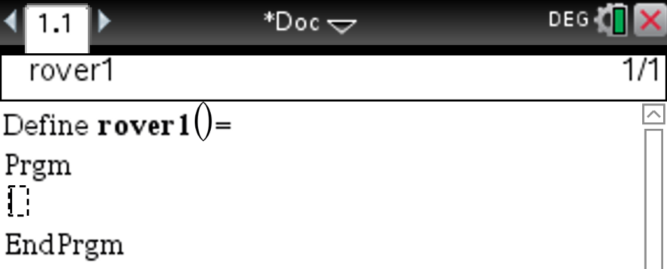

Slide 10
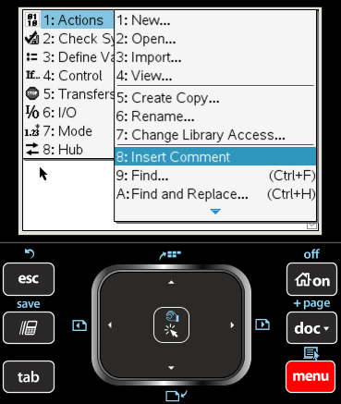

Slide 11
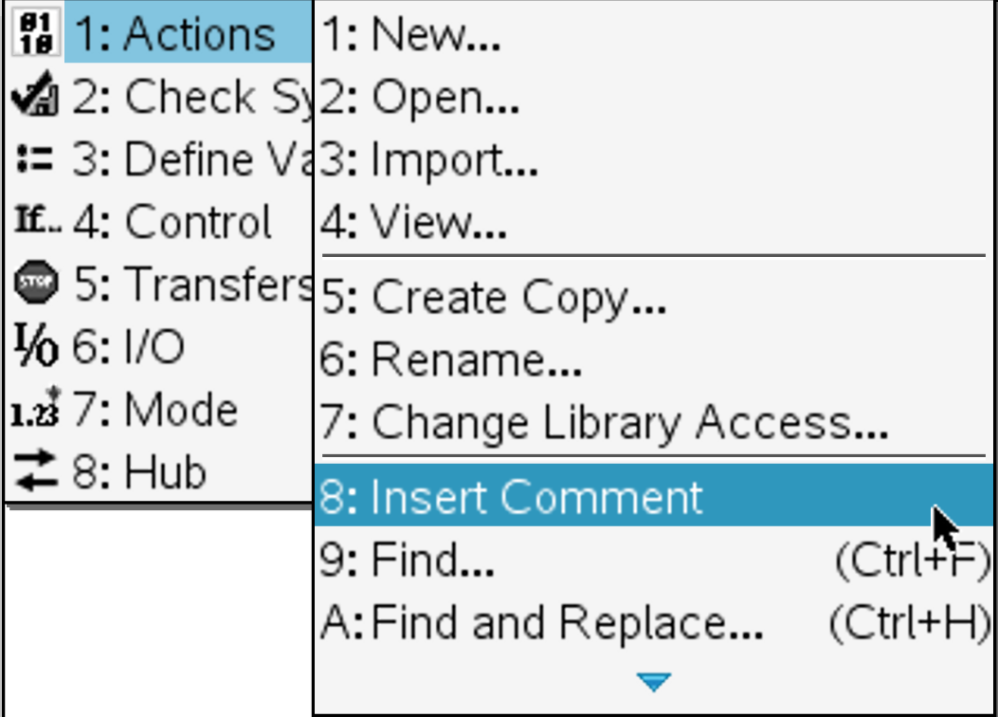

Slide 12
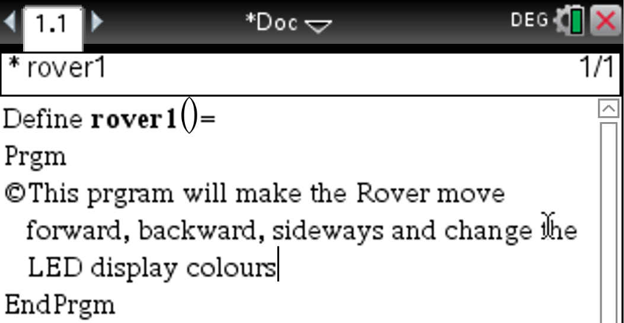

Slide 13
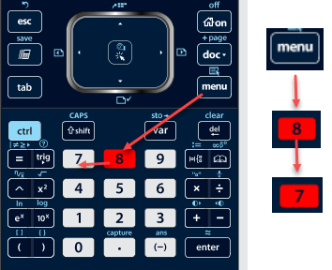
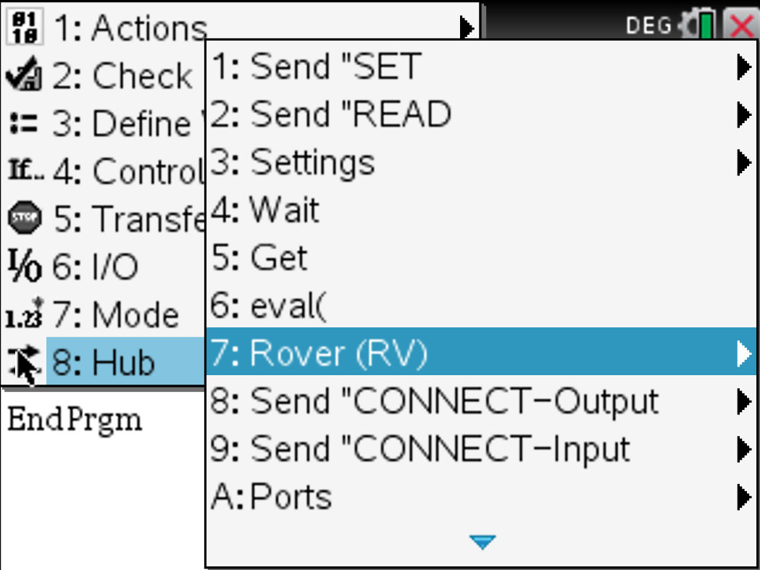

Slide 14
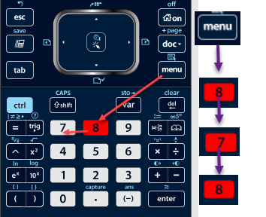
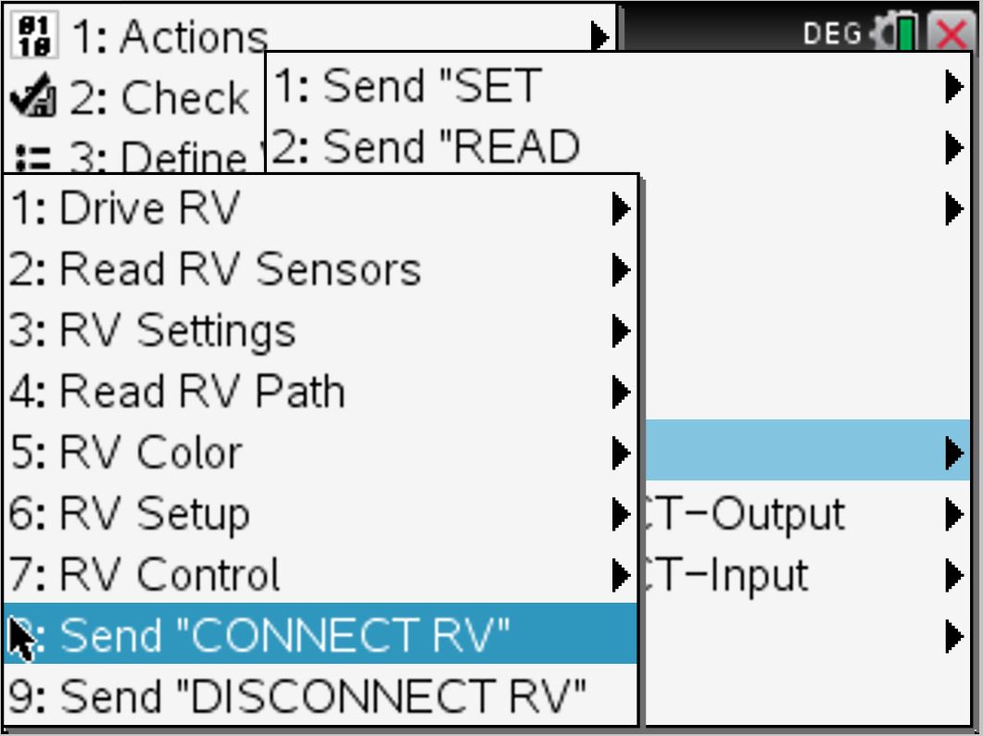

Slide 15
This is an essential command, every time the ROVER is used

Slide 16
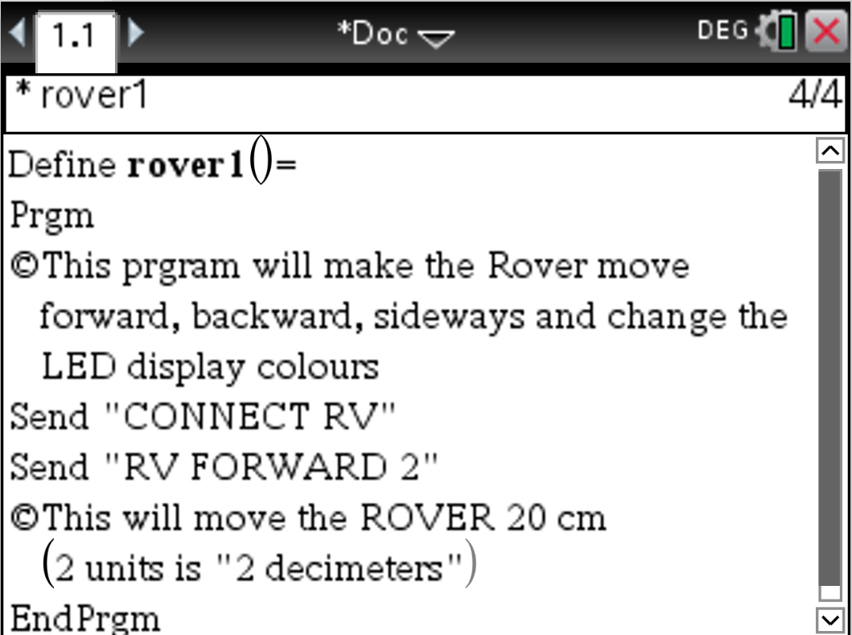
To Insert Comment

Slide 17
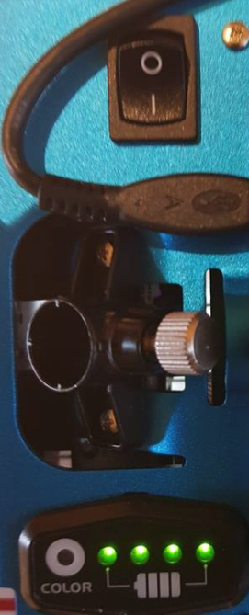
Will check the SYNTAX and STORE
Short-cut
Let’s Test and run the program
Ensure that the ROVER switch is turned on
RUN
Will RUN the program
Short-cut

Slide 18
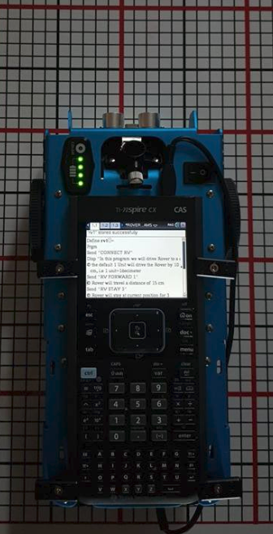

Slide 19
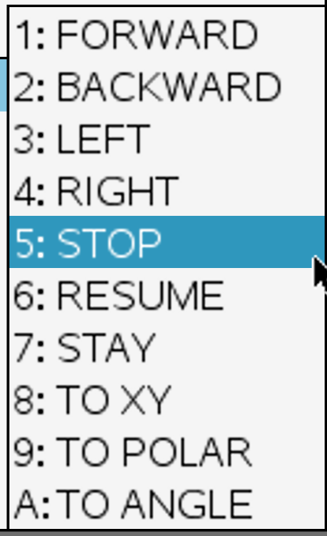
Explore the other Contextual menus
under the Drive Rover Command
Challenge
Make the Rover drive back (reverse) by 30 cm
Make the Rover turn left and drive 15 cm
Start a New Program and get the Rover to form a Square of sides 25 cm.

Slide 20
Try each of these
Conclusions
Default setting for Left or Right is 90 DEGREES
Default angle setting is in DEGREES

Slide 21
Try these now

Slide 22
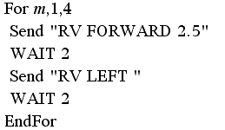
Rover to form a Square of sides 25 cm.
This is a loop or repetitive command
Each time
The Rover Drives 25 cm
Then Turns Left or Right
This happens 4 times
Try:
Try this command:
For WAIT
You can execute this command without the wait command, however it is advisable to use WAIT
if we, want the ROVER to execute another command
Like changing LED colour etc

Slide 23
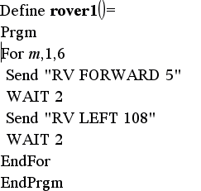
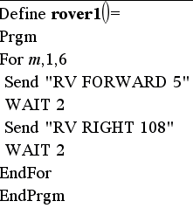
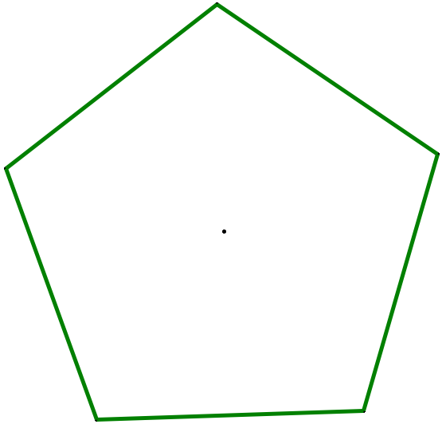
What do you think will happen with this code?
Are these going to do the same thing?
Correction: Change angle to 72 instead of 108

Slide 24
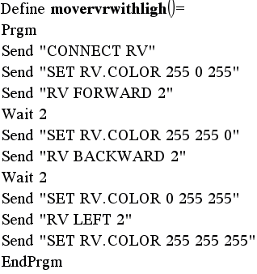
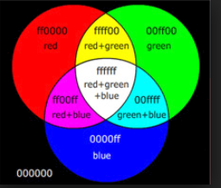
Try this new Program
Where do you think you fill find the
SET RV. COLOR command?
RGB
0-255
Intensity
Control scale
of Each
Colour
0 is absence of
the colour
255 is full intensity

Slide 25
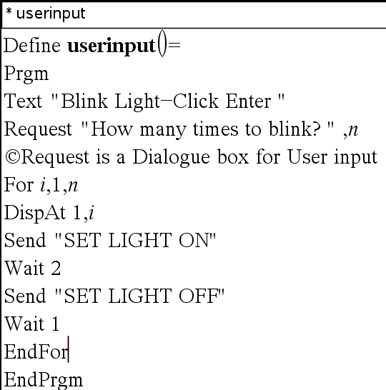
User Input in a Program (assigning a parameter and value)
Display Information / Output of (in) a program

Slide 26
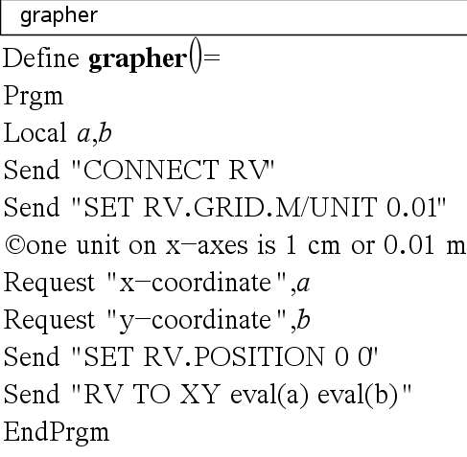
What is this program doing?
It is setting a Grid scale
Requesting 2 inputs
X and y coordinates
3. It will treat the current
position of the Rover
as the Origin
4. Will move the Rover
to the point(a,b)
5. Observe the use of the eval() command

Slide 27
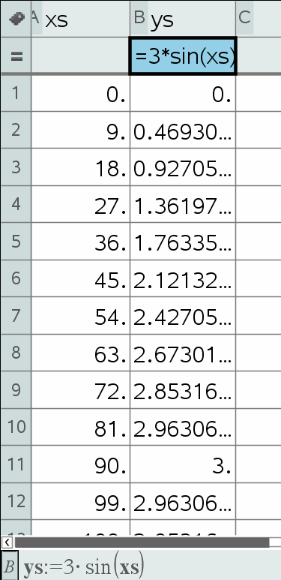
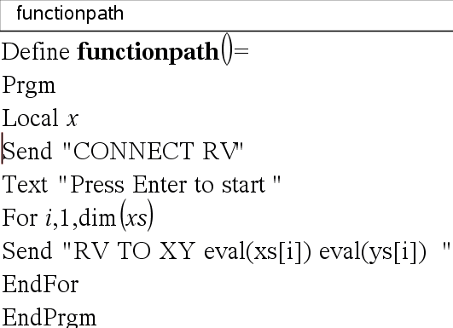
Getting Rover to draw a Cartesian graph
In this case it picks up x and y values from List and Spread sheet page
We can graph the function directly by Requesting a function, specifying the domain (use the For command to generate ) X and y values

Slide 28
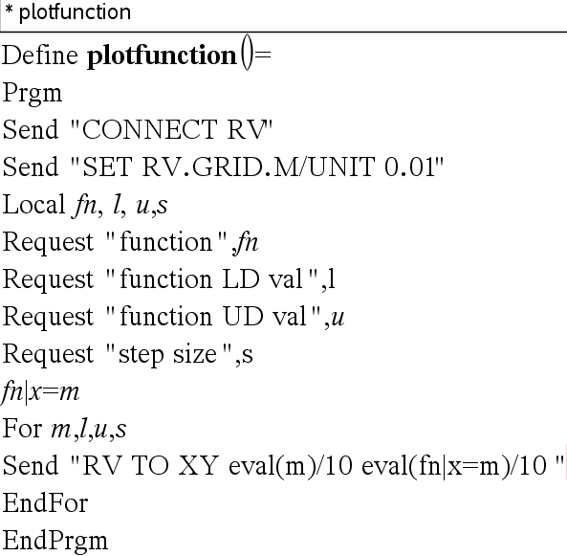
Plot a Function

Slide 29
RV FORWARD [[SPEED s] [DISTANCE d] [TIME t]]
 | Send ("RV FORWARD 0.5 M") Send ("RV FORWARD SPEED 0.22 M/S TIME 10") [SET] RV FORWARD [SET] RV FORWARD [DISTANCE] d [M|UNIT|REV] [SET] RV FORWARD [DISTANCE] d [M|UNIT|REV] SPEED s.ss [M/S|[UNIT/S]|REV/S] [SET] RV FORWARD [DISTANCE] d [M|UNIT|REV] TIME t [SET] RV FORWARD SPEED s [M/S|UNIT/S|REV/S] [TIME t] [SET] RV FORWARD TIME t [SPEED s.ss [M/S|[UNIT/S]|REV/S]]

Slide 30
Send "RV LEFT"
[SET] RV LEFT [ddd [DEGREES]]
[SET] RV LEFT [rrr RADIANS]
[SET] RV LEFT [ggg GRADIANS]
Default turn is 90 degrees unless DEGREES, RADIANS, or GRADIANS keyword is present, and then the value is converted internally to degrees format from the specified units. Value given is ranged to a value between 0.0 and 360.0 degrees. The turn will be executed as a SPIN motion.

Slide 31
Send "SET RV.MOTORS"
[SET] RV.MOTORS [LEFT][CW|CCW]
<pwm value|BRAKE|COAST>
[RIGHT][CW|CCW]
<pwm value|BRAKE|COAST>
[DISTANCE ddd [M|[UNITS]
[REV|FT]]
| [TIME s.ss]
Send "READ RV.COLORINPUT.RED"
Get (C)
Send("SET RV.COLOR 255 0 255")

Slide 32
RV STOP
Code Sample: | Send "RV STOP" [SET] RV STOP [SET] RV STOP CLEAR
Range: | N/A
Describe: | The RV will stop any current movement immediately. That movement can be resumed from where it left off with a RESUME operation. Any movement commands will cause the queue to flush immediately, and begin the just-posted new movement operation
Command: | RV STAY
Code Sample: | Send "RV STAY" RV STAY 4.50 s.ss] [SET] RV STAY [[TIME] s.ss]
Range: | N/A
Describe: | Tells RV to "stay" in place for an optionally specified amount of time in seconds. Default is 30.0 seconds.
Result: | RV stays in position.

Slide 33
Command: RV TO XY
Command Syntax: | RV TO XY x-coordinate y-coordinate [[SPEED] s.ss [UNIT/S]|M/S|REV/S] [XYLINE]
Code Sample: | Send "RV TO XY 1 1" Send "RV TO XY eval(X) eval(Y)" Send "RV TO XY -2 4 SPEED 0.19 M/S"
Range: | -327 to +327 for X and Y coordinates
Describe: | This command controls the movement of Rover on a virtual grid. Default location at start of program execution is (0,0) with Rover facing the positive x-axis. The x and y coordinates match the current grid size (default: 0.1 M/grid unit). Grid size can be changed through “SET RV.GRID.M/UNIT“ command The speed parameter is optional.
Result: | Moves Rover from current grid location to the specified grid location.

Slide 34
Command: RV TO POLAR
Command Syntax: | RV TO POLAR R-coordinate Theta-coordinate [[DEGREES]|RADIANS|GRADS] [[SPEED] s.ss [UNIT/S]|M/S|REV/S] [XYLINE]
Code Sample: | Send("RV TO POLAR 5 30") where r = 5 units, theta = 30 degrees Send("RV TO POLAR 5 2 RADIANS") Send("RV TO POLAR eval(sqrt(3^2+4^2)) eval(tan-1(4/3) DEGREES ")
Range: | Theta-coordinate: -360 to +360 degrees R-coordinate: -327 to +327
Describe: | Moves the RV from its current position to the specified polar position relative to that position. The RV's X/Y position will be updated to reflect the new position. The “r” coordinate matches the current grid size (default: 0.1 M/grid unit). Default location at start of program execution is (0,0) with Rover facing the positive x-axis. Default unit of theta is Degrees. The speed parameter is optional.

Slide 35
Command:RV TO ANGLE
Command Syntax: | RV TO ANGLE (Different from Turn Right or Left)
Code Sample: | Send "RV TO ANGLE" Send "RV TO ANGLE 46.25" [SET] RV TO ANGLE rr.rr [[DEGREES]|RADIANS|GRADIANS]
Result: | Spins the RV to the specified angle from current heading.
Type or Addressable Component: | Control Note: This Rover control command is sent and executed in a queue.

Slide 36
Command:RV TO ANGLE
Command Syntax: | RV TO ANGLE (Different from Turn Right or Left)
Code Sample: | Send "RV TO ANGLE" Send "RV TO ANGLE 46.25" [SET] RV TO ANGLE rr.rr [[DEGREES]|RADIANS|GRADIANS]
Result: | Spins the RV to the specified angle from current heading.
Type or Addressable Component: | Control Note: This Rover control command is sent and executed in a queue.

Slide 37
Lets look at some programming with the
Innovator HUB and Innovator Rover
Program 1 : Grapher

Slide 38
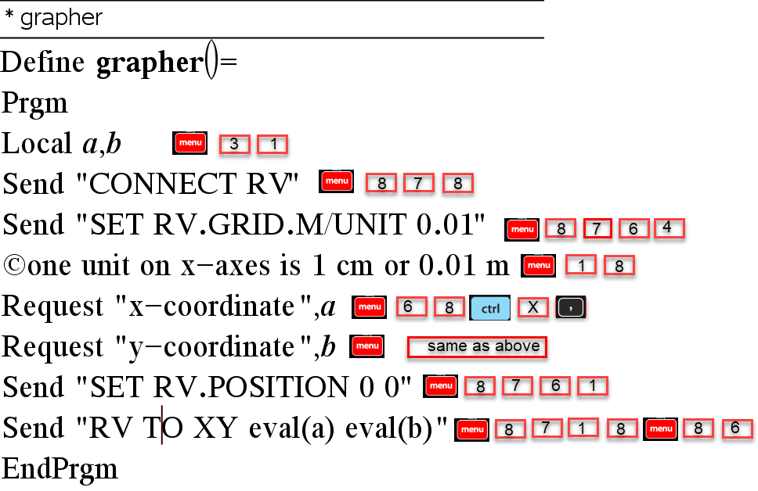

Slide 39
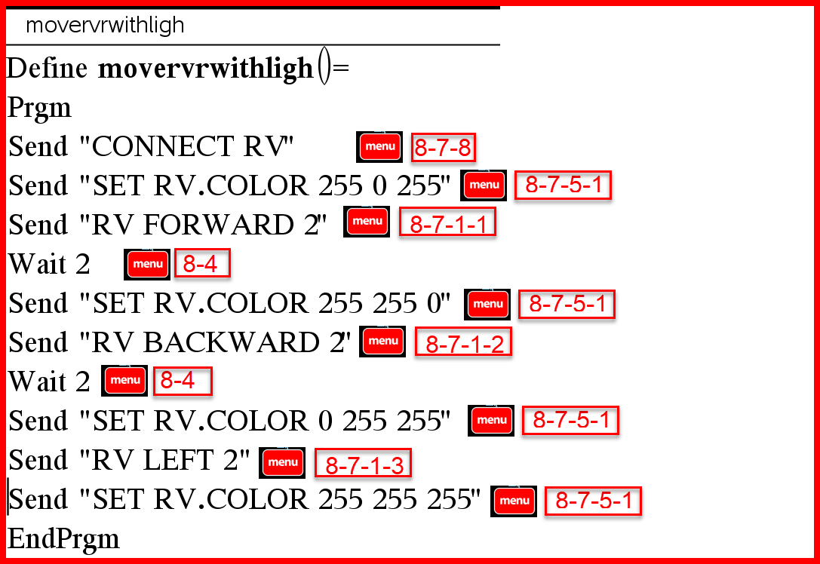

Slide 40
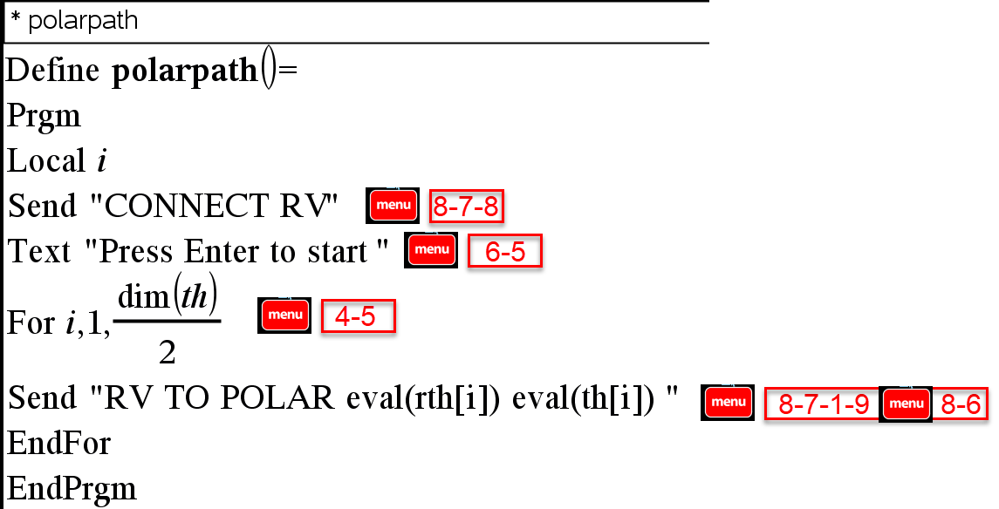

Slide 42
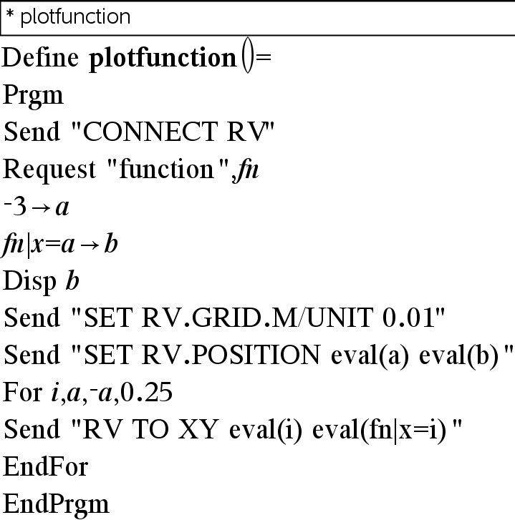

Slide 43
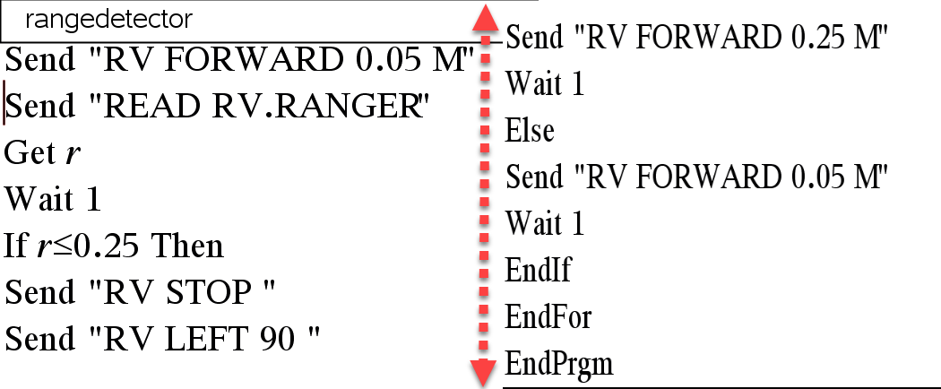

Slide 44
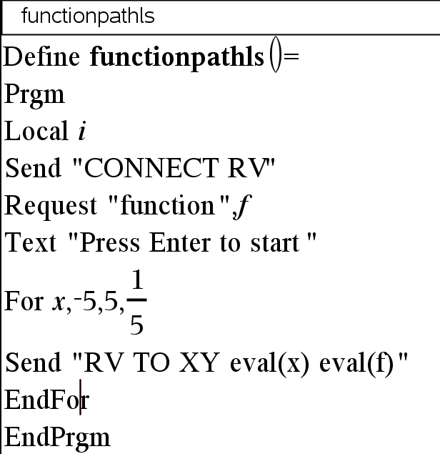

Slide 45
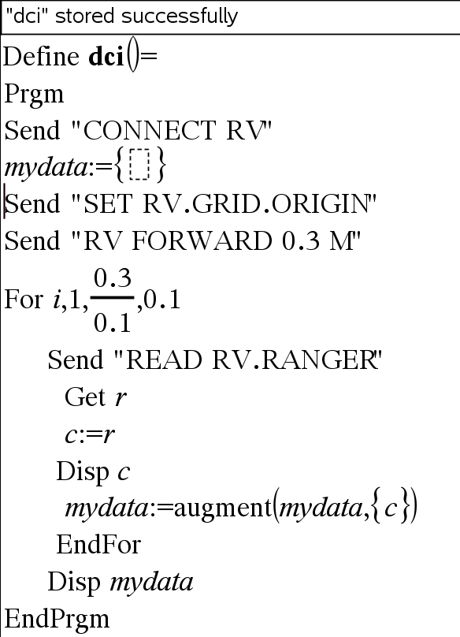
Ranger

Slide 46
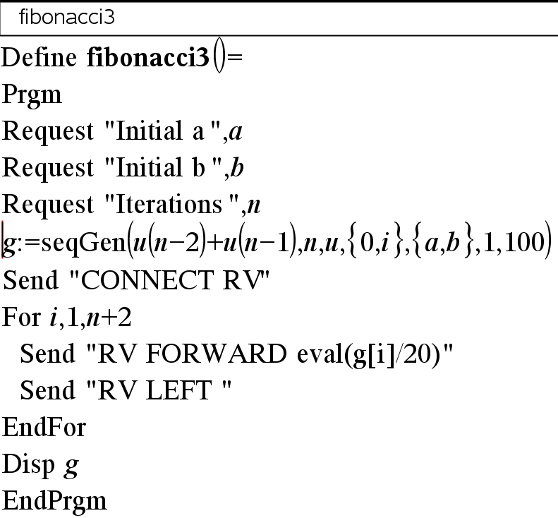

Slide 47
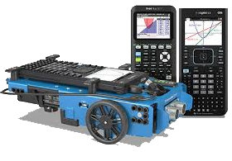
Starting point:
Link 1: 10 Minutes of Coding

Slide 48
Activities on the web
Link 2: STEM Activities
Link 3 : https://education.ti.com/en/resources/stem

Slide 49
Learn Vectors with TI Innovator Rover and use the TI innovator hub in the Physics classroom to improve conceptual understanding
This session will focus on use of TI technology (TI nspire CAS CX, The Innovator hub and TI innovator Rover) to improve conceptual understanding of certain concepts in Physics.
The session will have a STEM focus as we will model / simulate Physics activities using coding, graphing and designing practical activities.
The TI innovator Rover (A robotic vehicle will be programmed to follow a linear paths with variable parameters). This motion and path will be then be used to do a mathematical and physics analysis of the motion.
Using the TI Innovator Rover to understand Vectors and Bearings will be an initial introductory activity.

